Slide 1

CSC334 - Parallel & Distributed Computing
Chapter 8: Fault Tolerance
Mr. Aoun Haider, Ms. Muntaha Amjad

Slide 2
Dependability
Fault tolerance Introduction to fault tolerance
Basics
A component provides services to clients. To provide services, the component may require the services from other components ⇒ a component may depend on some other component.
Specifically
A component C depends on C∗ if the correctness of C’s behavior depends on the correctness of C∗’s behavior. (Components are processes or channels.)
Basic concepts

Slide 3
Dependability
Fault tolerance Introduction to fault tolerance
Basics
A component provides services to clients. To provide services, the component may require the services from other components ⇒ a component may depend on some other component.
Specifically
A component C depends on C∗ if the correctness of C’s behavior depends on the correctness of C∗’s behavior. (Components are processes or channels.)
Requirements related to dependability
Requirement | Description
Availability | Readiness for usage
Reliability | Continuity of service delivery
Safety | Very low probability of catastrophes
Maintainability | How easy can a failed system be repaired
Basic concepts

Slide 4
Reliability versus availability
Fault tolerance Introduction to fault tolerance
Reliability R(t ) of component C
Conditional probability that C has been functioning correctly during [0, t ) given
C was functioning correctly at time T = 0.
Traditional metrics
Mean Time To Failure (MTTF): The average time until a component fails.
Mean Time To Repair (MTTR): The average time needed to repair a component.
Mean Time Between Failures (MTBF): Simply MTTF + MTTR.
Basic concepts

Slide 5
Reliability versus availability
Fault tolerance Introduction to fault tolerance
Availability A(t ) of component C
Average fraction of time that C has been up-and-running in interval [0, t ).
Long-term availability A: A(∞)
_{Note: A =} MTTF ₌ MTTF
MTBF MTTF+MTTR
Observation
Reliability and availability make sense only if we have an accurate notion of what a failure actually is.
Basic concepts

Slide 6
Fault tolerance
Introduction to fault tolerance
Terminology
Failure, error, fault
Term | Description | Example
Failure | A component is not living up to its specifications | Crashed program
Error | Part of a component that can lead to a failure | Programming bug
Fault | Cause of an error | Sloppy programmer
Faults are classified as:
Transient occurs once and disappears
Intermittent occurs, then vanishes then reappears, and so on
Permanent continues to exist until the faulty component is replaced (disk-head crash, burnt-out chips)
Basic concepts

Slide 7
Fault tolerance
Introduction to fault tolerance
Terminology
Handling faults
Term | Description | Example
Fault prevention | Prevent the occurrence of a fault | Don’t hire sloppy programmers
Fault tolerance | Build a component such that it can mask the occurrence of a fault | Build each component by two independent programmers
Fault removal | Reduce the presence, number, or seriousness of a fault | Get rid of sloppy programmers
Fault forecasting | Estimate current presence, future incidence, and consequences of faults | Estimate how a recruiter is doing when it comes to hiring sloppy programmers
Basic concepts

Slide 8
Fault tolerance
Introduction to fault tolerance
Failure models
Types of failures
Type | Description of server’s behavior
Crash failure | Halts, but is working correctly until it halts
Omission failure Receive omission Send omission | Fails to respond to incoming requests Fails to receive incoming messages Fails to send messages
Timing failure | Response lies outside a specified time interval
Response failure Value failure State-transition failure | Response is incorrect The value of the response is wrong Deviates from the correct flow of control
Arbitrary failure | May produce arbitrary responses at arbitrary times
Failure models
Notes:
Receive omission: client and server connected but no thread is listening to incoming request
Send omission: Sender buffer overflows and content discarded
Timing failure: Video streaming providing data too soon (Receiver out of space) or too late(performance degradation).
Value failure: Search engine that systematically returns Web pages not related to any of the search terms used.

Slide 9
Dependability versus security
Fault tolerance Introduction to fault tolerance
Omission versus commission
Arbitrary failures are sometimes qualified as malicious. It is better to make the following distinction:
Omission failures: a component fails to take an action that it should have taken
Commission failure: a component takes an action that it should not have taken
Failure models

Slide 10
Dependability versus security
Fault tolerance Introduction to fault tolerance
Omission versus commission
Arbitrary failures are sometimes qualified as malicious. It is better to make the following distinction:
Omission failures: a component fails to take an action that it should have taken
Commission failure: a component takes an action that it should not have taken
Observation
Note that deliberate failures, be they omission or commission failures, are typically security problems. Distinguishing between deliberate failures and unintentional ones is, in general, impossible.
Failure models

Slide 11
Halting failures
Fault tolerance Introduction to fault tolerance
Scenario
C no longer perceives any activity from C∗ — a halting failure? Distinguishing between a crash or omission/timing failure may be impossible.
Asynchronous versus synchronous systems
Asynchronous system: no assumptions about process execution speeds or message delivery times → cannot reliably detect crash failures.
Synchronous system: process execution speeds and message delivery times are bounded → we can reliably detect omission and timing failures.
In practice we have partially synchronous systems: most of the time, we can assume the system to be synchronous, yet there is no bound on the time that a system is asynchronous → can normally reliably detect crash failures.
Failure models

Slide 12
Fault tolerance
Introduction to fault tolerance
Halting failures
Assumptions we can make
Halting type | Description
Fail-stop | Crash failures, but reliably detectable
Fail-noisy | Crash failures, eventually reliably detectable
Fail-silent | Omission or crash failures: clients cannot tell what went wrong
Fail-safe | Arbitrary, yet benign failures (i.e., they cannot do any harm)
Fail-arbitrary | Arbitrary, with malicious failures
Failure models

Slide 13
Redundancy for failure masking
Fault tolerance Introduction to fault tolerance
Types of redundancy
Information redundancy: Add extra bits to data units so that errors can recovered when bits are garbled. i.e., Hamming codes with extra bits
Time redundancy: Design a system such that an action can be performed again if anything went wrong. Typically used when faults are transient or intermittent. i.e. Transactions abort in databases
Physical redundancy: add equipment or processes i.e., allow one or more components to fail. This type is extensively used in distributed systems. i.e., Process replication to use service via some other one
Failure masking by redundancy

Slide 14
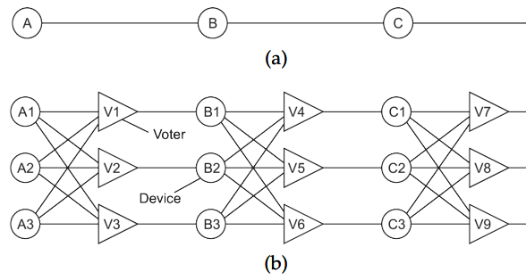
Triple Modular Redundancy (TMR)
Fault tolerance Introduction to fault tolerance
Redundancy is also applied in design of digital electronics. In the figure(a), A circuit consist of three different components but fail in will result in entire circuit failure. Now consider the figure(b), a stage of triplicated voter is added, and voter is also redundant because they can be faulty as well. Now if B3 and C1 fails, it will still return accurate result.
Failure masking by redundancy

Slide 15
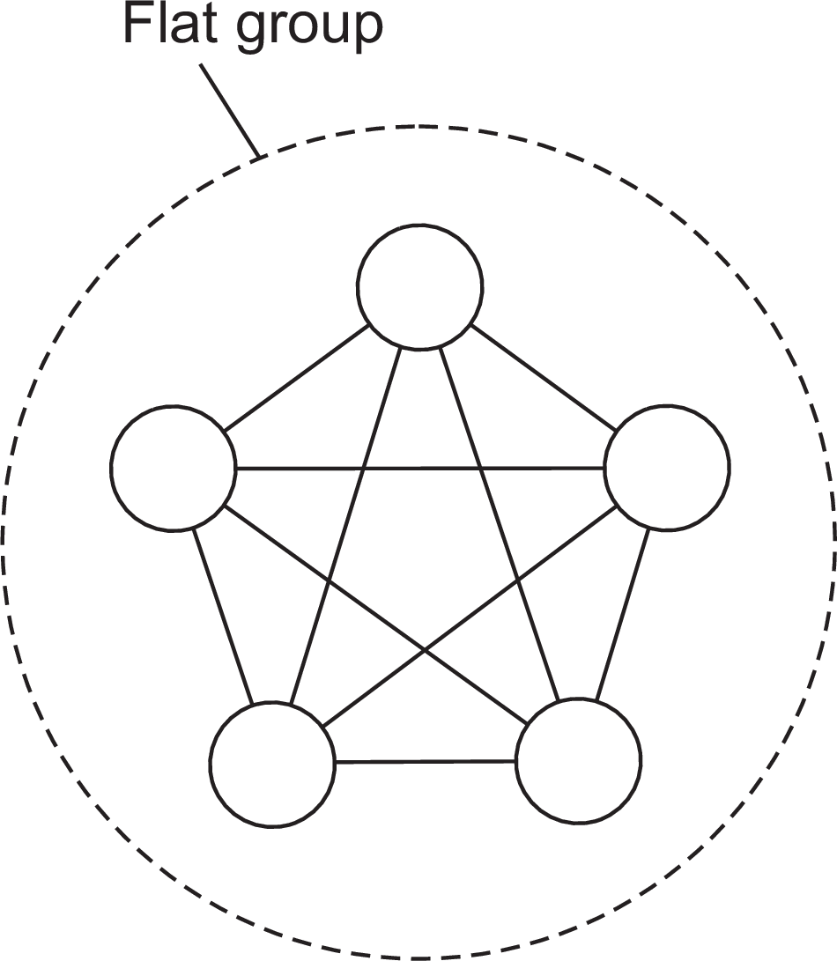
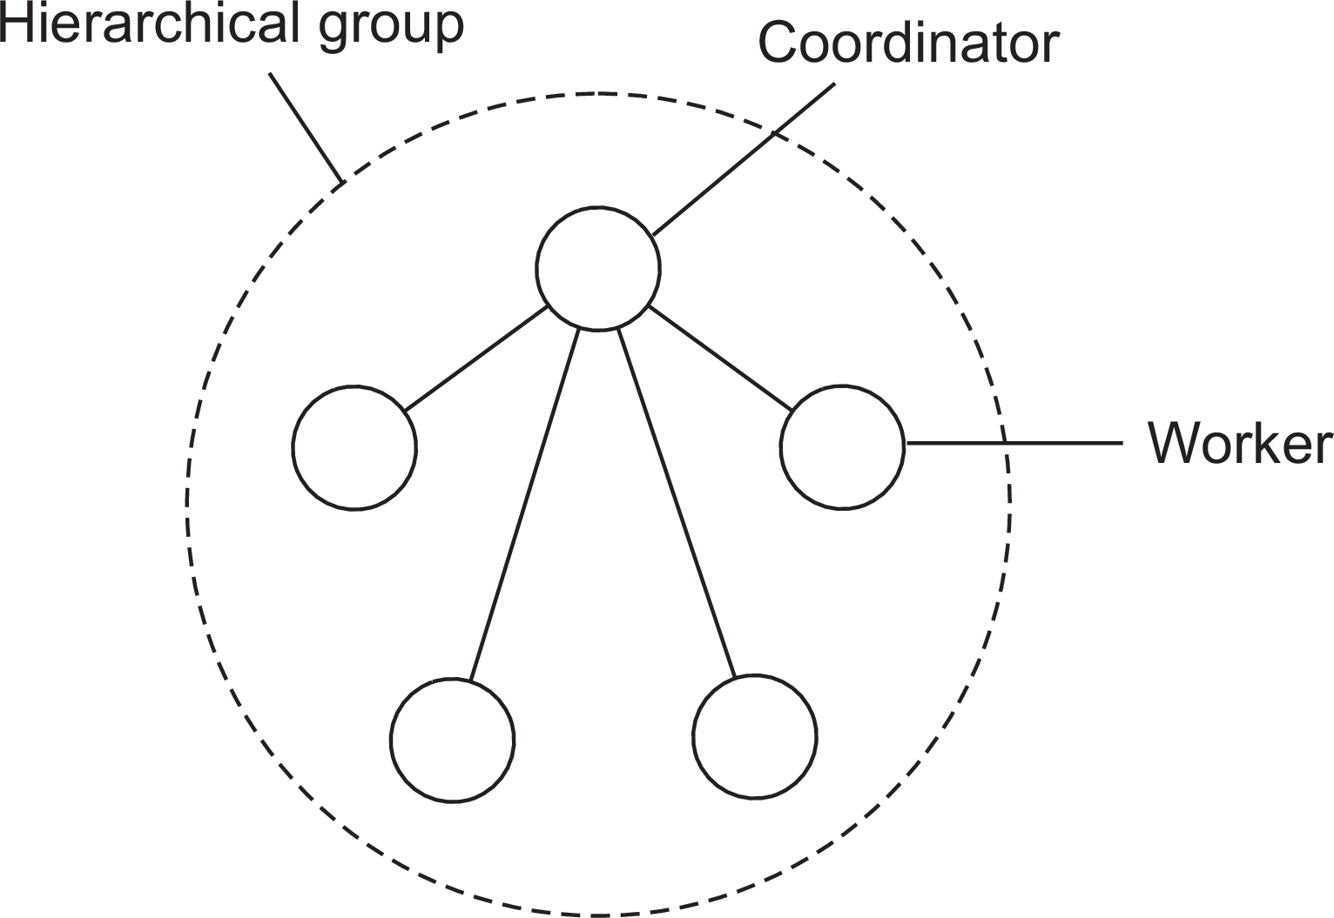
Process resilience
Fault tolerance Process resilience
Basic idea
Protect against malfunctioning processes through process replication, organizing multiple processes into a process group. Distinguish between flat groups and hierarchical groups.
Flat group Decision making is complicated, voting mechanism is used to decided which one among all will respond.
Hierarchical group Single point of failure, other workers can take placing using election algorithms.
Resilience by process groups

Slide 16
Groups and failure masking
Fault tolerance Process resilience
k -fault tolerant group
When a group can mask any k concurrent member failures (k is called degree of fault tolerance).
Failure masking and replication

Slide 17
Groups and failure masking
Fault tolerance Process resilience
k -fault tolerant group
When a group can mask any k concurrent member failures (k is called degree of fault tolerance).
How large does a k -fault tolerant group need to be?
With halting failures (crash/omission/timing failures): we need a total of k + 1 members as no member will produce an incorrect result, so the result of one member is good enough.
With arbitrary failures: we need 2k + 1 members so that the correct result can be obtained through a majority vote.
Failure masking and replication

Slide 18
Groups and failure masking
Fault tolerance Process resilience
k -fault tolerant group
When a group can mask any k concurrent member failures (k is called degree of fault tolerance).
How large does a k -fault tolerant group need to be?
With halting failures (crash/omission/timing failures): we need a total of k + 1 members as no member will produce an incorrect result, so the result of one member is good enough.
With arbitrary failures: we need 2k + 1 members so that the correct result can be obtained through a majority vote.
Important assumptions
All members are identical
All members process commands in the same order
Result: We can now be sure that all processes do exactly the same thing.
Failure masking and replication

Slide 19
Consensus
Fault tolerance Process resilience
Prerequisite
In a fault-tolerant process group, each nonfaulty process executes the same commands, and in the same order, as every other nonfaulty process.
Reformulation
Nonfaulty group members need to reach consensus on which command to execute next.
Consensus in faulty systems with crash failures

Slide 20
Fault tolerance
Process resilience
Flooding-based consensus
System model
A process group P = {P₁,..., P_{n}}
Fail-stop failure semantics, i.e., with reliable failure detection
A client contacts a P_{i} requesting it to execute a command
Every P_{i} maintains a list of proposed commands
Consensus in faulty systems with crash failures

Slide 21
Fault tolerance
Process resilience
Flooding-based consensus
System model
A process group P = {P₁,..., P_{n}}
Fail-stop failure semantics, i.e., with reliable failure detection
A client contacts a P_{i} requesting it to execute a command
Every P_{i} maintains a list of proposed commands
Basic algorithm (based on rounds)
1. In round r , P_{i} multicasts its known set of commands C^{r} to all others
i
r+1
2. At the end of r , each P merges all received commands into a new C .
i
i
3. Next command cmd_{i} selected through a globally shared, deterministic
r+1
function: cmd ← select (C ).
i
i
Consensus in faulty systems with crash failures

Slide 22
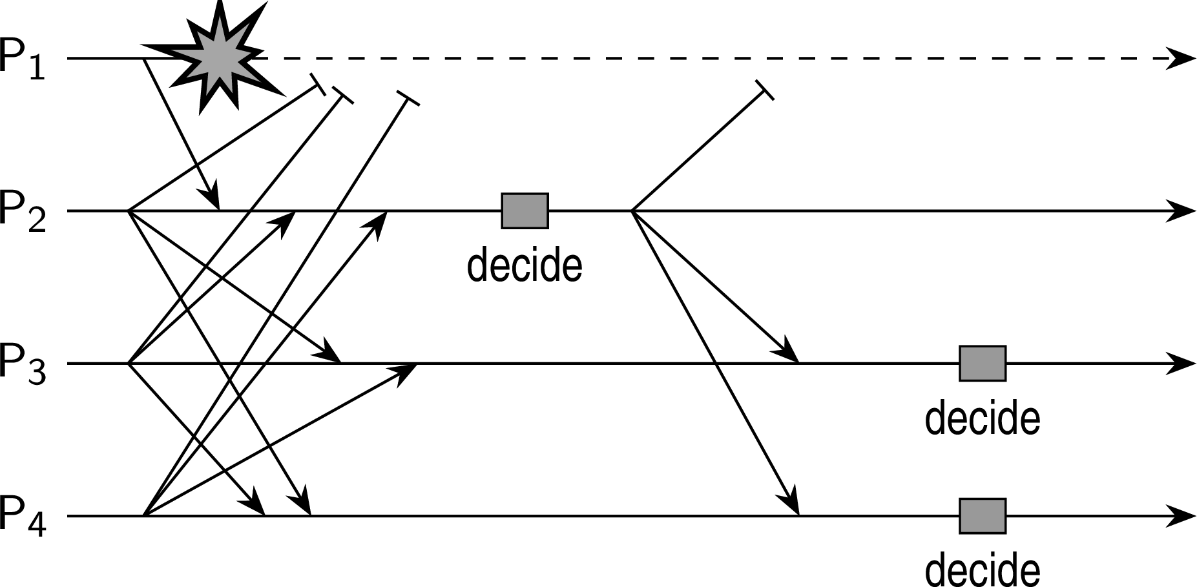
Fault tolerance
Process resilience
Flooding-based consensus: Example
Observations
P₂ received all proposed commands from all other processes ⇒ makes decision.
P₃ may have detected that P₁ crashed, but does not know if P₂ received anything, i.e., P₃ cannot know if it has the same information as P₂ ⇒ cannot make decision (same for P₄ ).
Consensus in faulty systems with crash failures

Slide 23
Raft
Fault tolerance Process resilience
Developed for understandability
Uses a fairly straightforward leader-election algorithm (see Chp. 5). The current leader operates during the current term.
Every server (typically, five) keeps a log of operations, some of which have been committed. A backup will not vote for a new leader if its own log is more up to date.
All committed operations have the same position in the log of each respective server.
The leader decides which pending operation is to be committed next ⇒ a primary-backup approach.
Consensus in faulty systems with crash failures

Slide 24
Fault tolerance
Process resilience
Raft
When submitting an operation
A client submits a request for operation o.
The leader appends the request ⟨o, t , ⟩ to its own log (registering the current term t and length of ).
The log is (conceptually) broadcast to the other servers.
The others (conceptually) copy the log and acknowledge the receipt.
When a majority of acks arrives, the leader commits o.
Consensus in faulty systems with crash failures

Slide 25
Fault tolerance
Process resilience
Raft
When submitting an operation
A client submits a request for operation o.
The leader appends the request ⟨o, t , ⟩ to its own log (registering the current term t and length of ).
The log is (conceptually) broadcast to the other servers.
The others (conceptually) copy the log and acknowledge the receipt.
When a majority of acks arrives, the leader commits o.
Note
In practice, only updates are broadcast. At the end, every server has the same view and knows about the c committed operations. Note that effectively, any information at the backups is overwritten.
Consensus in faulty systems with crash failures

Slide 26
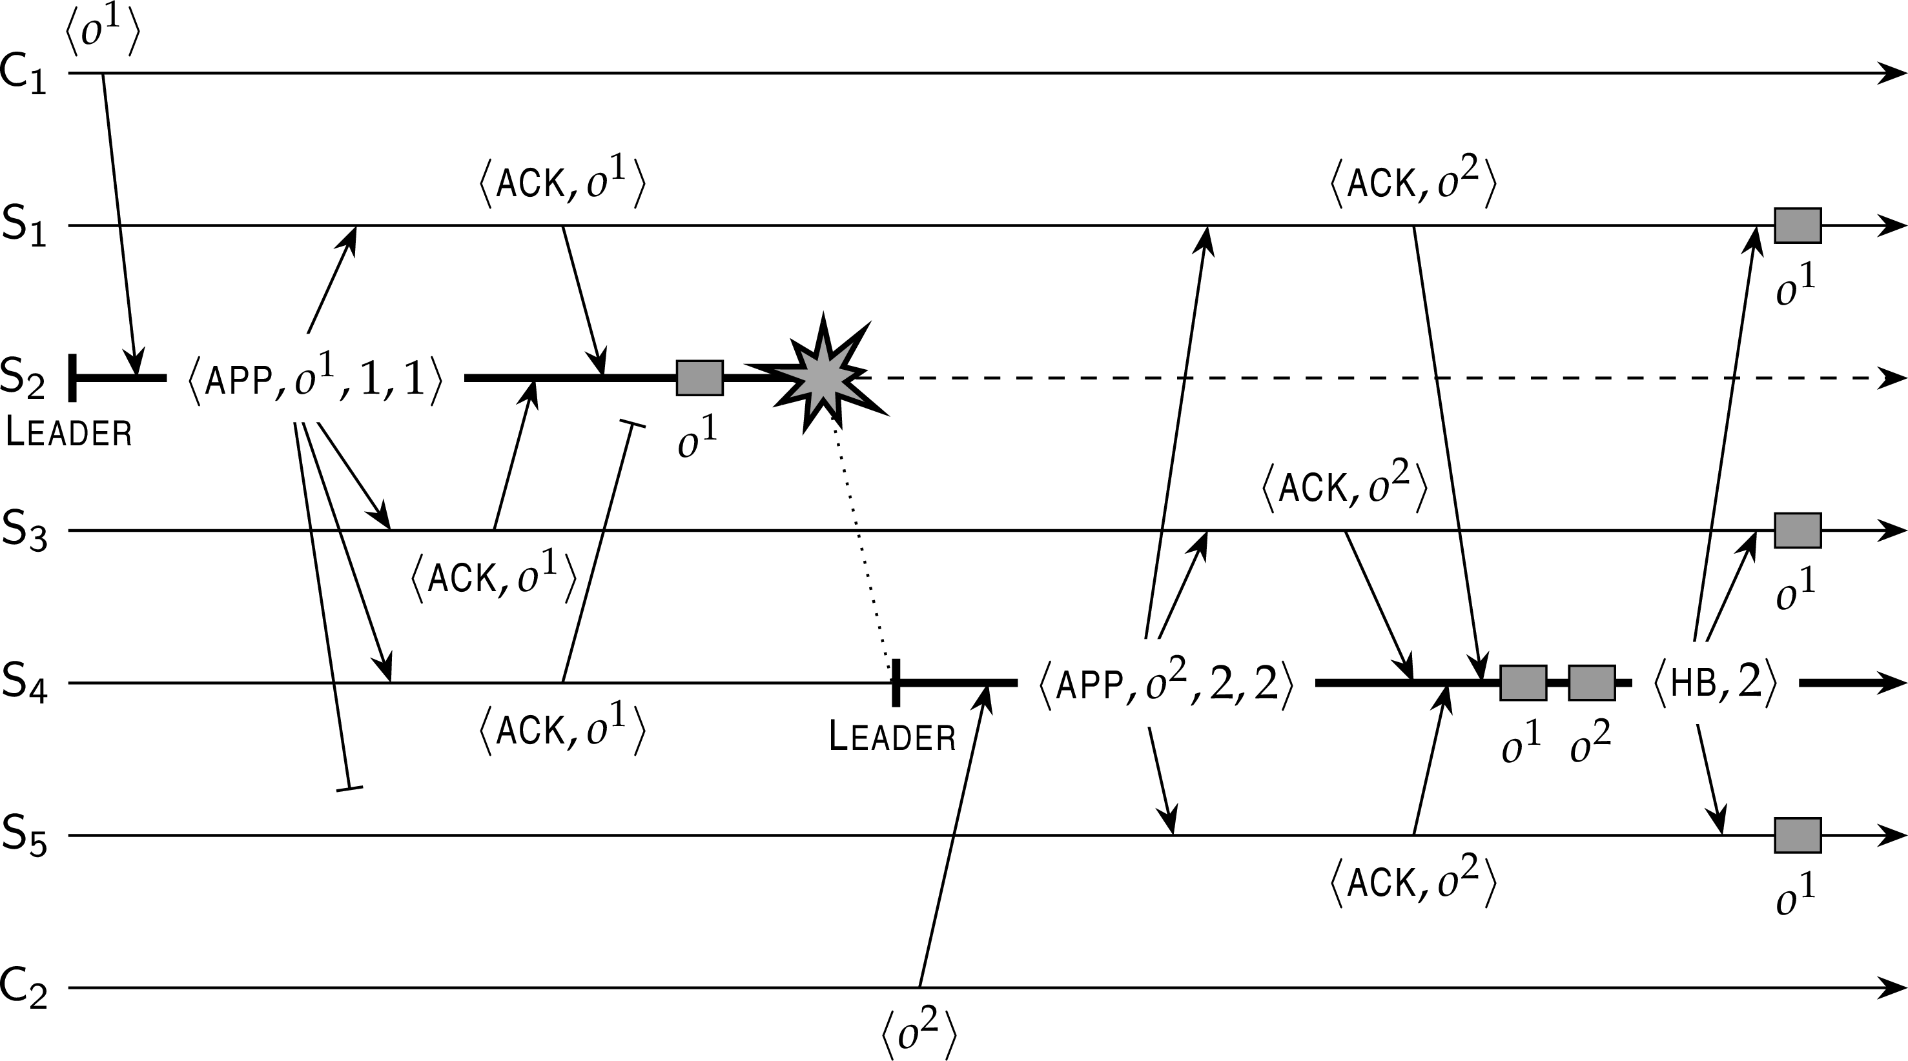
Fault tolerance
Process resilience
Raft: when a leader crashes
Crucial observations
The new leader has the most committed operations in its log.
Any missing commits will eventually be sent to the other backups.
Consensus in faulty systems with crash failures

Slide 27
Realistic consensus: Paxos
Fault tolerance Process resilience
Assumptions (rather weak ones, and realistic)
A partially synchronous system (in fact, it may even be asynchronous).
Communication between processes may be unreliable: messages may be lost, duplicated, or reordered.
Corrupted message can be detected (and thus subsequently ignored).
All operations are deterministic: once an execution is started, it is known exactly what it will do.
Processes may exhibit crash failures, but not arbitrary failures.
Processes do not collude.
Understanding Paxos
We will build up Paxos from scratch to understand where many consensus algorithms actually come from.
Example: Paxos

Slide 28
Paxos essentials
Fault tolerance Process resilience
Starting point
We assume a client-server configuration, with initially one primary server.
To make the server more robust, we start with adding a backup server.
To ensure that all commands are executed in the same order at both servers, the primary assigns unique sequence numbers to all commands. In Paxos, the primary is called the leader.
Assume that actual commands can always be restored (either from clients or servers) ⇒ we consider only control messages.
Example: Paxos

Slide 29
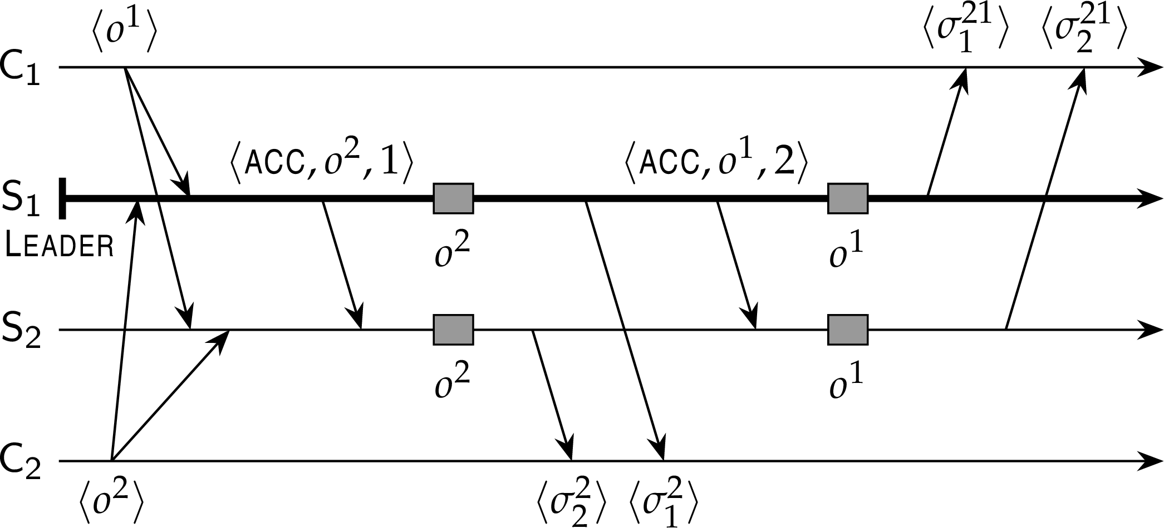
Fault tolerance
Process resilience
Two-server situation
Example: Paxos

Slide 30
Fault tolerance
Process resilience
Handling lost messages
Some Paxos terminology
The leader sends an accept message ACCEPT(o, t ) to backups when assigning a timestamp t to command o.
A backup responds by sending a learn message: LEARN(o, t )
When the leader notices that operation o has not yet been learned, it retransmits ACCEPT(o, t ) with the original timestamp.
Example: Paxos

Slide 31
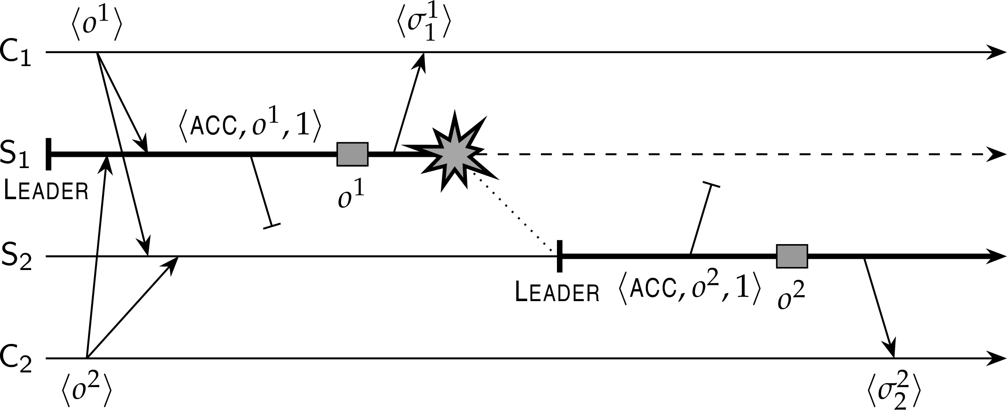
Fault tolerance
Process resilience
Two servers and one crash: problem
Problem
Primary crashes after executing an operation, but the backup never received the accept message.
Example: Paxos

Slide 32
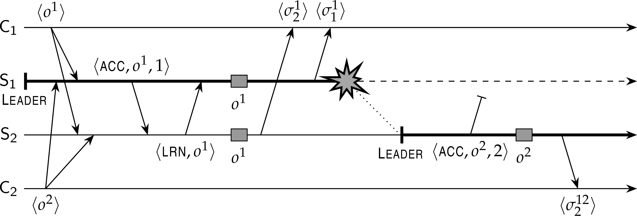
Fault tolerance
Process resilience
Two servers and one crash: solution
Solution
Never execute an operation before it is clear that is has been learned.
Example: Paxos

Slide 33
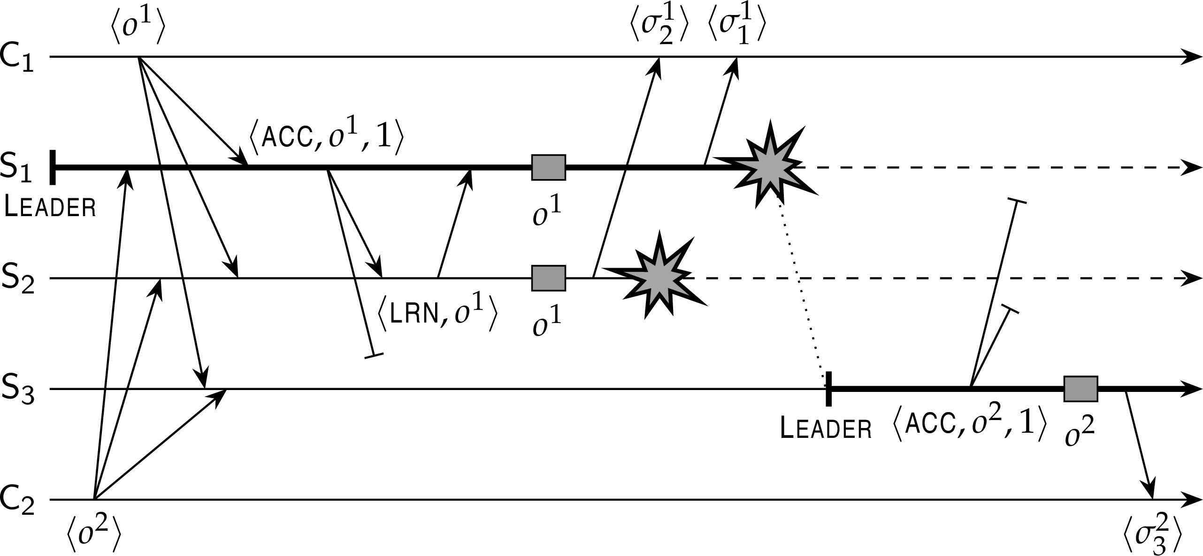
Fault tolerance
Process resilience
Three servers and two crashes: still a problem?
Example: Paxos

Slide 34
Fault tolerance
Process resilience
Three servers and two crashes: still a problem?
Scenario
What happens when LEARN(o¹) as sent by S₂ to S₁ is lost?
Example: Paxos

Slide 35
Fault tolerance
Process resilience
Three servers and two crashes: still a problem?
Scenario
What happens when LEARN(o¹) as sent by S₂ to S₁ is lost?
Solution
S₂ will also have to wait until it knows that S₃ has learned o¹.
Example: Paxos

Slide 36
Fault tolerance
Process resilience
Paxos: fundamental rule
General rule
In Paxos, a server S cannot execute an operation o until it has received a
LEARN(o) from all other nonfaulty servers.
Example: Paxos

Slide 37
Failure detection
Fault tolerance Process resilience
Practice
Reliable failure detection is practically impossible. A solution is to set timeouts, but take into account that a detected failure may be false.
Example: Paxos

Slide 38
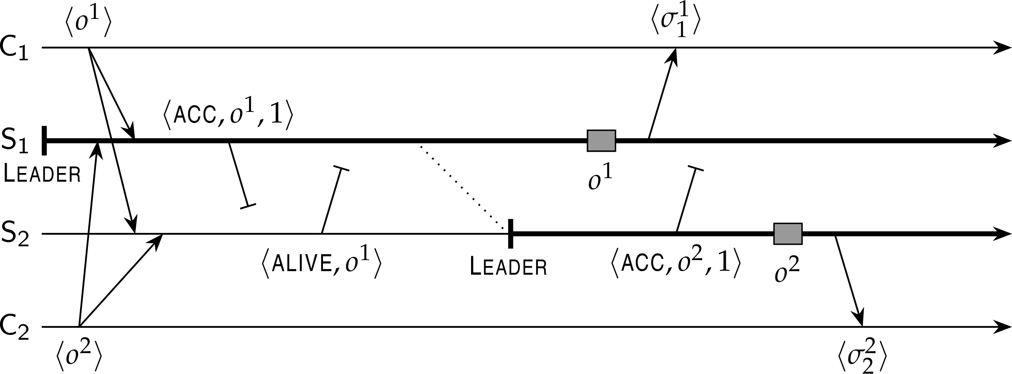
Failure detection
Fault tolerance Process resilience
Practice
Reliable failure detection is practically impossible. A solution is to set timeouts, but take into account that a detected failure may be false.
Example: Paxos

Slide 39
Fault tolerance
Process resilience
Required number of servers
Observation
Paxos needs at least three servers
Example: Paxos

Slide 40
Required number of servers
Fault tolerance Process resilience
Observation
Paxos needs at least three servers
Adapted fundamental rule
In Paxos with three servers, a server S cannot execute an operation o until it has received at least one (other) LEARN(o) message, so that it knows that a majority of servers will execute o.
Example: Paxos

Slide 41
Required number of servers
Fault tolerance Process resilience
Assumptions before taking the next steps
Initially, S₁ is the leader.
A server can reliably detect it has missed a message, and recover from that miss.
When a new leader needs to be elected, the remaining servers follow a strictly deterministic algorithm, such as S₁ → S₂ → S₃ .
A client cannot be asked to help the servers to resolve a situation.
Example: Paxos

Slide 42
Required number of servers
Fault tolerance Process resilience
Assumptions before taking the next steps
Initially, S₁ is the leader.
A server can reliably detect it has missed a message, and recover from that miss.
When a new leader needs to be elected, the remaining servers follow a strictly deterministic algorithm, such as S₁ → S₂ → S₃ .
A client cannot be asked to help the servers to resolve a situation.
Observation
If either one of the backups (S₂ or S₃ ) crashes, Paxos will behave correctly: operations at nonfaulty servers are executed in the same order.
Example: Paxos

Slide 43
Fault tolerance
Process resilience
Leader crashes after executing o¹
Example: Paxos

Slide 44
Leader crashes after executing o¹
Fault tolerance Process resilience
S₃ is completely ignorant of any activity by S₁
S₂ received ACCEPT(o, 1), detects crash, and becomes leader.
S₃ even never received ACCEPT(o, 1).
If S₂ sends ACCEPT(o² , 2) ⇒ S₃ sees unexpected timestamp and tells
S₂ that it missed o¹.
S₂ retransmits ACCEPT(o¹, 1), allowing S₃ to catch up.
Example: Paxos

Slide 45
Leader crashes after executing o¹
Fault tolerance Process resilience
S₃ is completely ignorant of any activity by S₁
S₂ received ACCEPT(o, 1), detects crash, and becomes leader.
S₃ even never received ACCEPT(o, 1).
If S₂ sends ACCEPT(o² , 2) ⇒ S₃ sees unexpected timestamp and tells
S₂ that it missed o¹.
S₂ retransmits ACCEPT(o¹, 1), allowing S₃ to catch up.
S₂ missed ACCEPT(o¹, 1)
S₂ did detect crash and became new leader
If S₂ sends ACCEPT(o¹, 1) ⇒ S₃ retransmits LEARN(o¹).
If S₂ sends ACCEPT(o² , 1) ⇒ S₃ tells S₂ that it apparently missed
ACCEPT(o¹, 1) from S₁, so that S₂ can catch up.
Example: Paxos

Slide 46
Fault tolerance
Process resilience
Leader crashes after sending ACCEPT(o¹, 1)
S₃ is completely ignorant of any activity by S₁
As soon as S₂ announces that o² is to be accepted, S₃ will notice that it missed an operation and can ask S₂ to help recover.
S₂ had missed ACCEPT(o¹, 1)
As soon as S₂ proposes an operation, it will be using a stale timestamp, allowing S₃ to tell S₂ that it missed operation o¹.
Example: Paxos

Slide 47
Leader crashes after sending ACCEPT(o¹, 1)
Fault tolerance Process resilience
S₃ is completely ignorant of any activity by S₁
As soon as S₂ announces that o² is to be accepted, S₃ will notice that it missed an operation and can ask S₂ to help recover.
S₂ had missed ACCEPT(o¹, 1)
As soon as S₂ proposes an operation, it will be using a stale timestamp, allowing S₃ to tell S₂ that it missed operation o¹.
Observation
Paxos (with three servers) behaves correctly when a single server crashes, regardless when that crash took place.
Example: Paxos

Slide 48
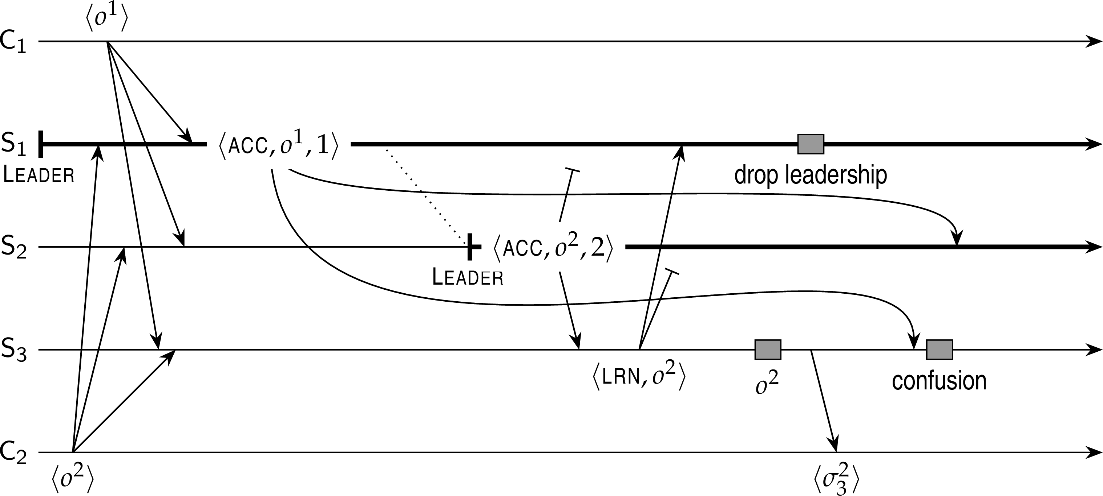
Fault tolerance
Process resilience
False crash detections
Problem and solution
S₃ receives ACCEPT(o¹, 1), but much later than ACCEPT(o² , 1). If it knew who the current leader was, it could safely reject the delayed accept message ⇒ leaders should include their ID in messages.
Example: Paxos

Slide 49
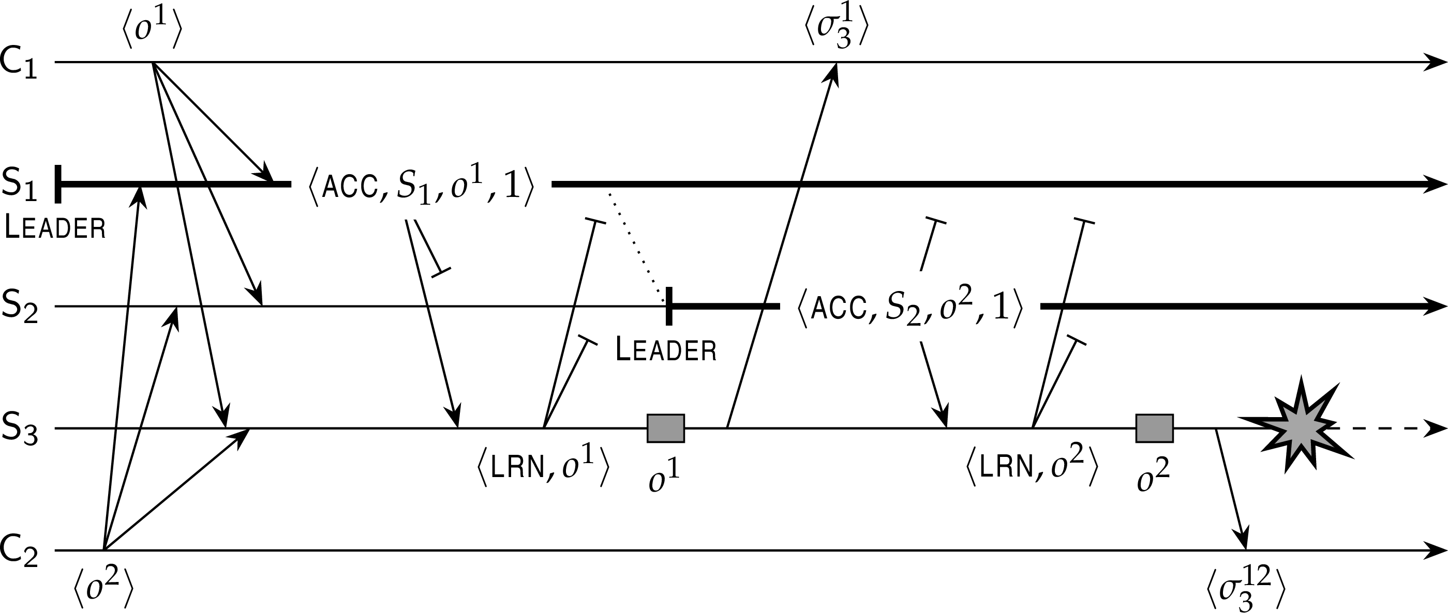
Fault tolerance
Process resilience
But what about progress?
Example: Paxos

Slide 50
Fault tolerance
Process resilience
But what about progress?
Essence of solution
When S₂ takes over, it needs to make sure that any outstanding operations initiated by S₁ have been properly flushed, i.e., executed by enough servers. This requires an explicit leadership takeover by which other servers are informed before sending out new accept messages.
Example: Paxos

Slide 51
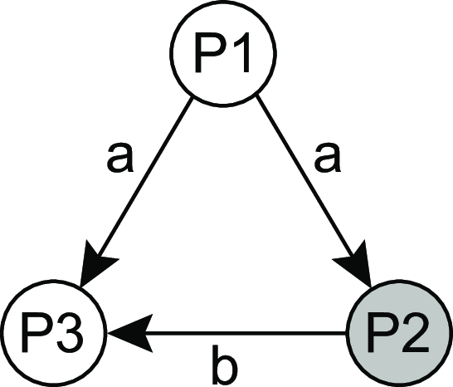
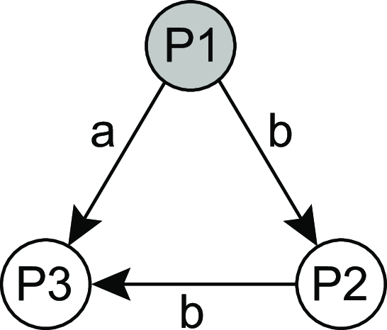
Fault tolerance
Process resilience
Consensus under arbitrary failure semantics
Essence
We consider process groups in which communication between process is inconsistent.
Improper forwarding
Different messages
Consensus in faulty systems with arbitrary failures

Slide 52
Fault tolerance
Process resilience
Consensus under arbitrary failure semantics
System model
We consider a primary P and n − 1 backups B₁,..., B_{n−1}.
A client sends v ∈ {T, F} to P
Messages may be lost, but this can be detected.
Messages cannot be corrupted beyond detection.
A receiver of a message can reliably detect its sender.
Byzantine agreement: requirements
BA1: Every nonfaulty backup process stores the same value.
BA2: If the primary is nonfaulty then every nonfaulty backup process stores exactly what the primary had sent.
Observation
Primary faulty ⇒ BA1 says that backups may store the same, but different (and thus wrong) value than originally sent by the client.
Primary not faulty ⇒ satisfying BA2 implies that BA1 is satisfied.
Consensus in faulty systems with arbitrary failures

Slide 53
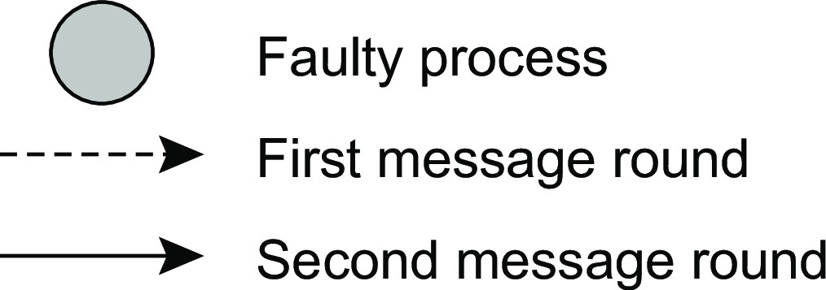
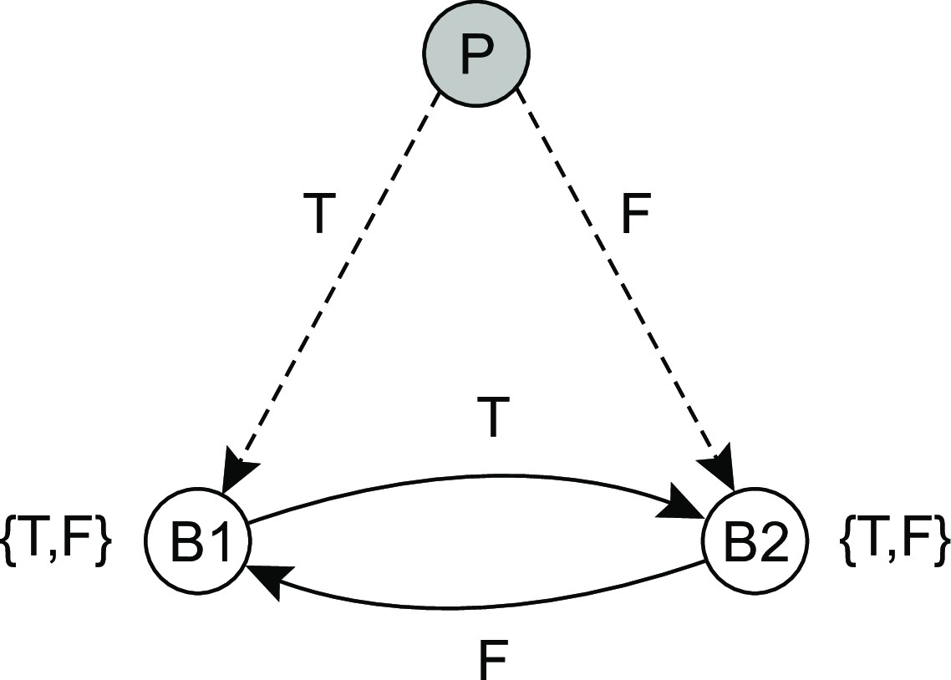
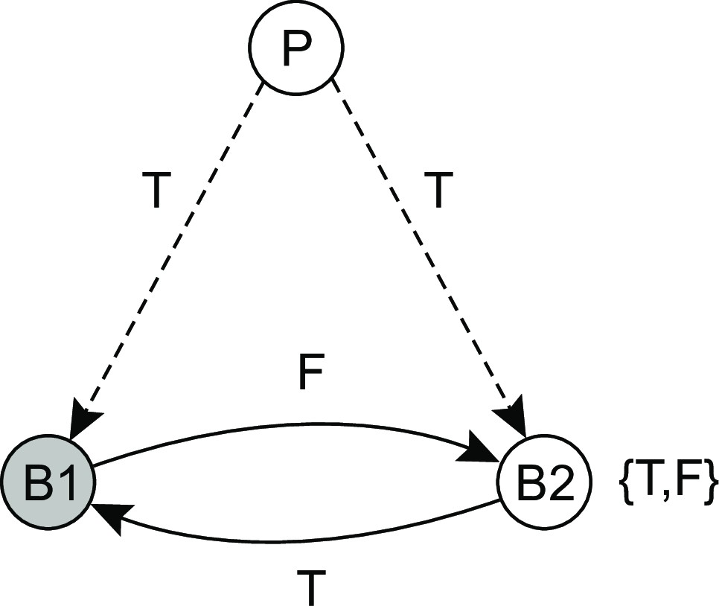
Fault tolerance
Process resilience
Why having 3k processes is not enough
Consensus in faulty systems with arbitrary failures

Slide 54
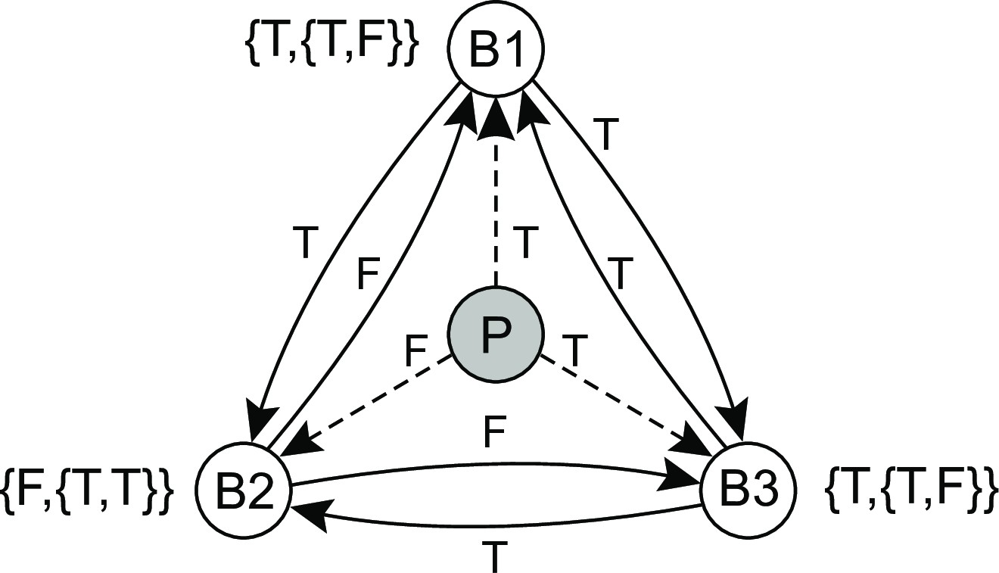
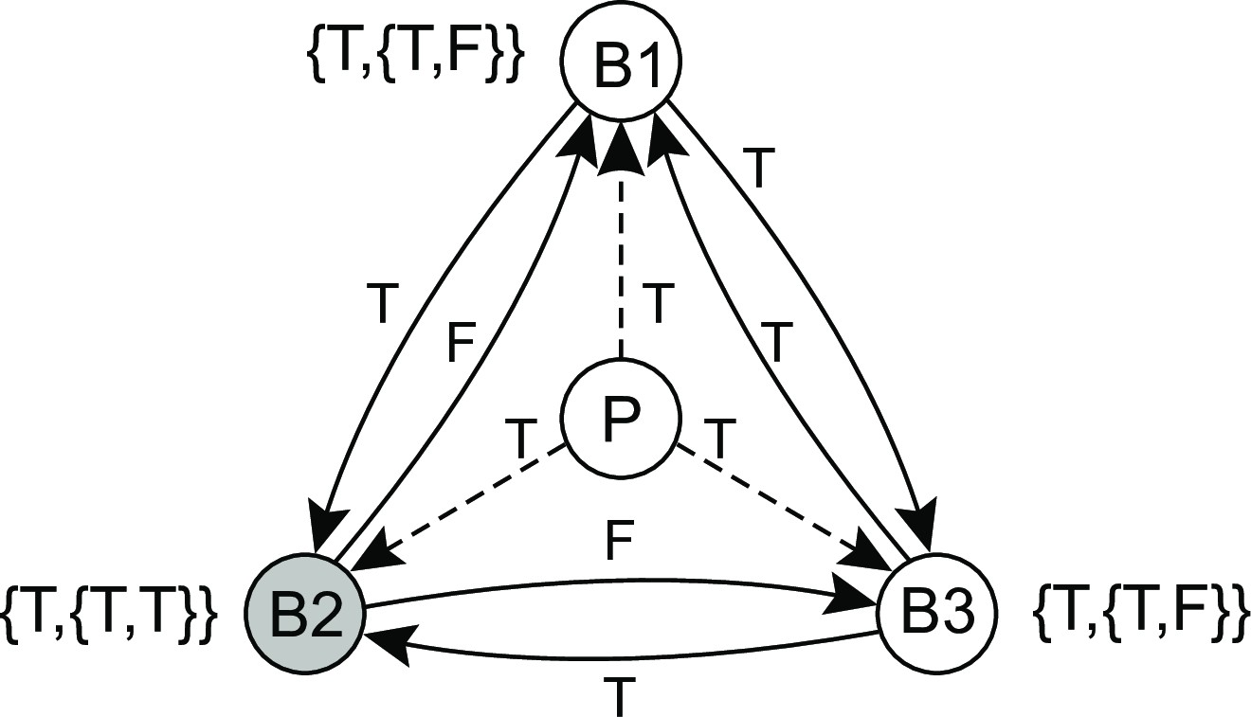
Fault tolerance
Process resilience
Why having 3k + 1 processes is enough
Consensus in faulty systems with arbitrary failures

Slide 55
Fault tolerance
Process resilience
Practical Byzantine Fault Tolerance (PBFT)
Background
One of the first solutions that managed to Byzantine fault tolerance while keeping performance acceptable. Popularity has increased with the introduction of permissioned blockchains.
Assumptions
A server may exhibit arbitrary failures
Messages may be lost, delayed, and received out of order
Messages have an identifiable sender (i.e., they are signed)
Partially synchronous execution model
Essence
A primary-backup approach with 3k + 1 replica servers.
Consensus in faulty systems with arbitrary failures

Slide 56
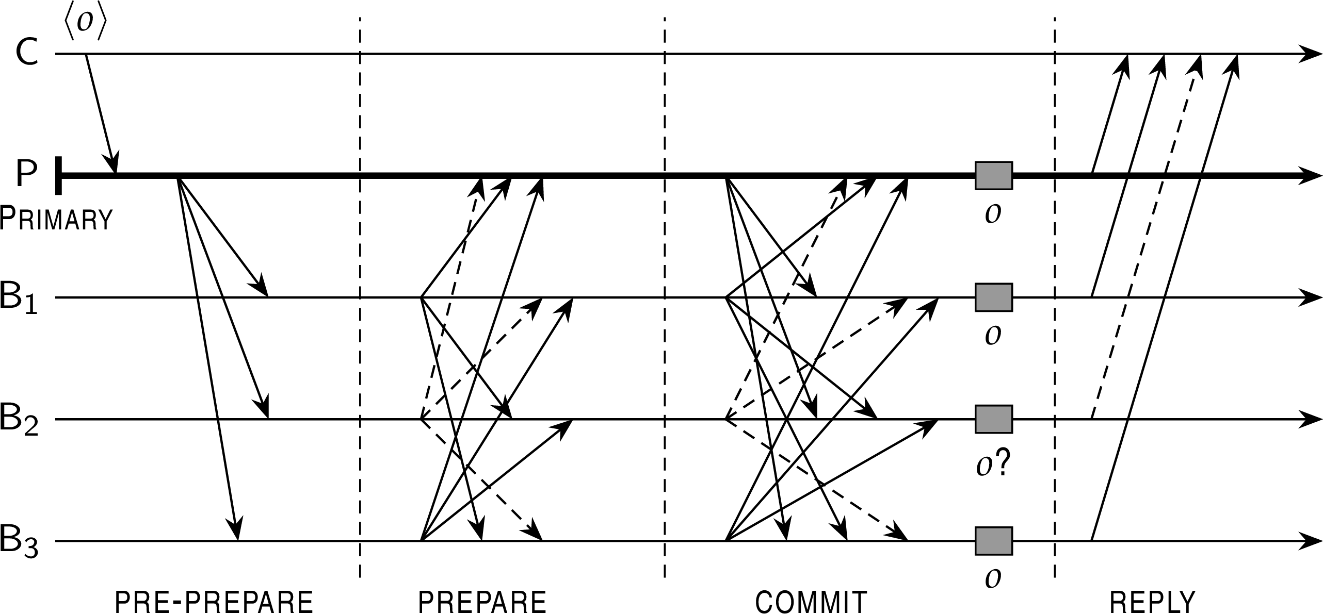
Fault tolerance
Process resilience
PBFT: four phases
C is the client
P is the primary
B₁, B₂ , B₃ are backups
Assume B₂ is faulty
Consensus in faulty systems with arbitrary failures

Slide 57
Fault tolerance
Process resilience
PBFT: four phases
All servers assume to be working in a current view v .
C requests operation o to be executed
P timestamps o and sends PRE-PREPARE(t, v, o)
Backup B_{i} accepts the pre-prepare message if it is also is in v and has not accepted a an operation with timestamp t before.
Consensus in faulty systems with arbitrary failures

Slide 58
Fault tolerance
Process resilience
PBFT: four phases
B_{i} broadcasts PREPARE(t, v, o) to all (including the primary)
Note: a nonfaulty server will eventually log 2k messages PREPARE(t, v, o)
(including its own) ⇒ consensus on the ordering of o.
Note: it doesn’t matter what faulty B₂ sends, it cannot affect joint decisions by P, B₁, B₃ .
Consensus in faulty systems with arbitrary failures

Slide 59
Fault tolerance
Process resilience
PBFT: four phases
All servers broadcast COMMIT(t, v, o)
The commit is needed to also make sure that o can be executed now, that is, in the current view v .
When 2k messages have been collected, excluding its own, the server can safely execute o en reply to the client.
Consensus in faulty systems with arbitrary failures

Slide 60
PBFT: when the primary fails
Fault tolerance Process resilience
Issue
When a backup detects the primary failed, it will broadcast a view change to view v + 1. We need to ensure that any outstanding request is executed once and only once by all nonfaulty servers. The operation needs to be handed over to the new view.
Procedure
The next primary P∗ is known deterministically
A backup server broadcasts VIEW-CHANGE(v + 1, P): P is the set of prepares it had sent out.
P∗ waits for 2k + 1 view-change messages, with X = ^{LJ} P containing all previously sent prepares.
P∗ sends out NEW-VIEW(v+1,X,O) with O a new set of pre-prepare messages.
Essence: this allows the nonfaulty backups to replay what has gone on in the previous view, if necessary, and bring o into the new view v + 1.
Consensus in faulty systems with arbitrary failures

Slide 61
Realizing fault tolerance
Fault tolerance Process resilience
Observation
Considering that the members in a fault-tolerant process group are so tightly coupled, we may bump into considerable performance problems, but perhaps even situations in which realizing fault tolerance is impossible.
Question
Are there limitations to what can be readily achieved?
What is needed to enable reaching consensus?
What happens when groups are partitioned?
Some limitations on realizing fault tolerance

Slide 62
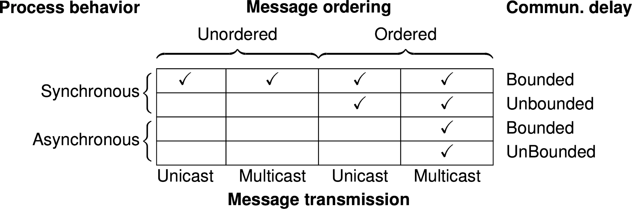
Fault tolerance
Process resilience
Distributed consensus: when can it be reached
Formal requirements for consensus
Processes produce the same output value
Every output value must be valid
Every process must eventually provide output
Some limitations on realizing fault tolerance

Slide 63
Consistency, availability, and partitioning
Fault tolerance Process resilience
CAP theorem
Any networked system providing shared data can provide only two of the following three properties:
C: consistency, by which a shared and replicated data item appears as a single, up-to-date copy
A: availability, by which updates will always be eventually executed P: Tolerant to the partitioning of process group.
Conclusion
In a network subject to communication failures, it is impossible to realize an atomic read/write shared memory that guarantees a response to every request.
Some limitations on realizing fault tolerance

Slide 64
Fault tolerance
Process resilience
CAP theorem intuition
Simple situation: two interacting processes
P and Q can no longer communicate:
Allow P and Q to go ahead ⇒ no consistency
Allow only one of P, Q to go ahead ⇒ no availability
P and Q have to be assumed to continue communication ⇒ no partitioning allowed.
Some limitations on realizing fault tolerance

Slide 65
Fault tolerance
Process resilience
CAP theorem intuition
Simple situation: two interacting processes
P and Q can no longer communicate:
Allow P and Q to go ahead ⇒ no consistency
Allow only one of P, Q to go ahead ⇒ no availability
P and Q have to be assumed to continue communication ⇒ no partitioning allowed.
Fundamental question
What are the practical ramifications of the CAP theorem?
Some limitations on realizing fault tolerance

Slide 66
Fault tolerance
Process resilience
Failure detection
Issue
How can we reliably detect that a process has actually crashed?
General model
Each process is equipped with a failure detection module
A process P probes another process Q for a reaction
If Q reacts: Q is considered to be alive (by P)
If Q does not react with t time units: Q is suspected to have crashed
Observation for a synchronous system
a suspected crash ≡ a known crash
Failure detection

Slide 67
Fault tolerance
Process resilience
Practical failure detection
Implementation
If P did not receive heartbeat from Q within time t : P suspects Q.
If Q later sends a message (which is received by P):
P stops suspecting Q
P increases the timeout value t
Note: if Q did crash, P will keep suspecting Q.
Failure detection

Slide 68
Fault tolerance
Reliable client-server communication
Reliable remote procedure calls
What can go wrong?
The client is unable to locate the server.
The request message from the client to the server is lost.
The server crashes after receiving a request.
The reply message from the server to the client is lost.
The client crashes after sending a request.
RPC semantics in the presence of failures

Slide 69
Fault tolerance
Reliable client-server communication
Reliable remote procedure calls
What can go wrong?
The client is unable to locate the server.
The request message from the client to the server is lost.
The server crashes after receiving a request.
The reply message from the server to the client is lost.
The client crashes after sending a request.
Two “easy” solutions
1: (cannot locate server): just report back to client 2: (request was lost): just resend message
RPC semantics in the presence of failures

Slide 70
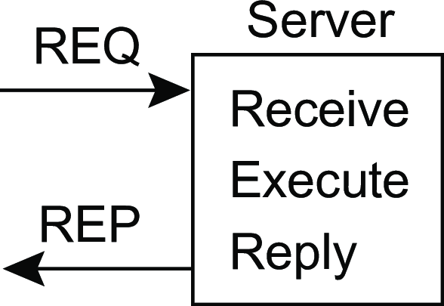
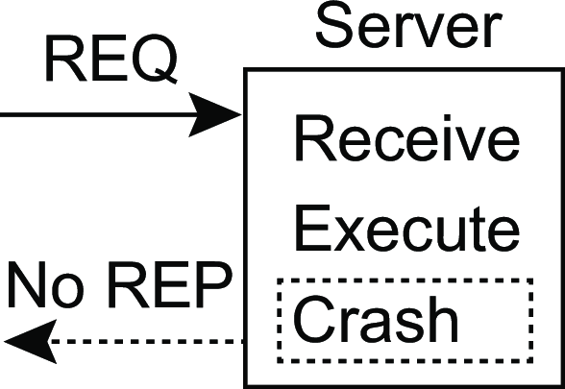
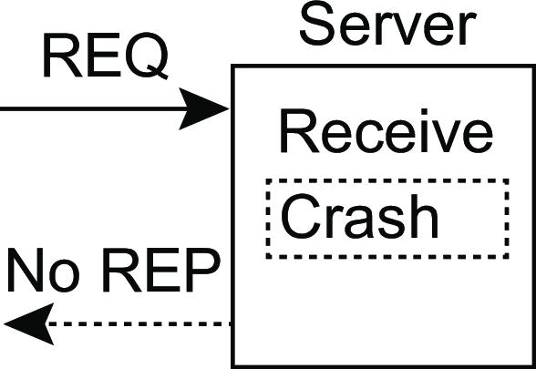
Fault tolerance
Reliable client-server communication
Reliable RPC: server crash
(a) (b) (c)
Problem
Where (a) is the normal case, situations (b) and (c) require different solutions. However, we don’t know what happened. Two approaches:
At-least-once-semantics: The server guarantees it will carry out an operation at least once, no matter what.
At-most-once-semantics: The server guarantees it will carry out an operation at most once.
RPC semantics in the presence of failures

Slide 71
Fault tolerance
Reliable client-server communication
Why fully transparent server recovery is impossible
Three type of events at the server
(Assume the server is requested to update a document.)
M: send the completion message
P: complete the processing of the document C: crash
Six possible orderings
(Actions between brackets never take place)
M → P → C: Crash after reporting completion.
M → C → P: Crash after reporting completion, but before the update.
P → M → C: Crash after reporting completion, and after the update.
P → C(→ M): Update took place, and then a crash.
C(→ P → M): Crash before doing anything
C(→ M → P): Crash before doing anything
RPC semantics in the presence of failures

Slide 72
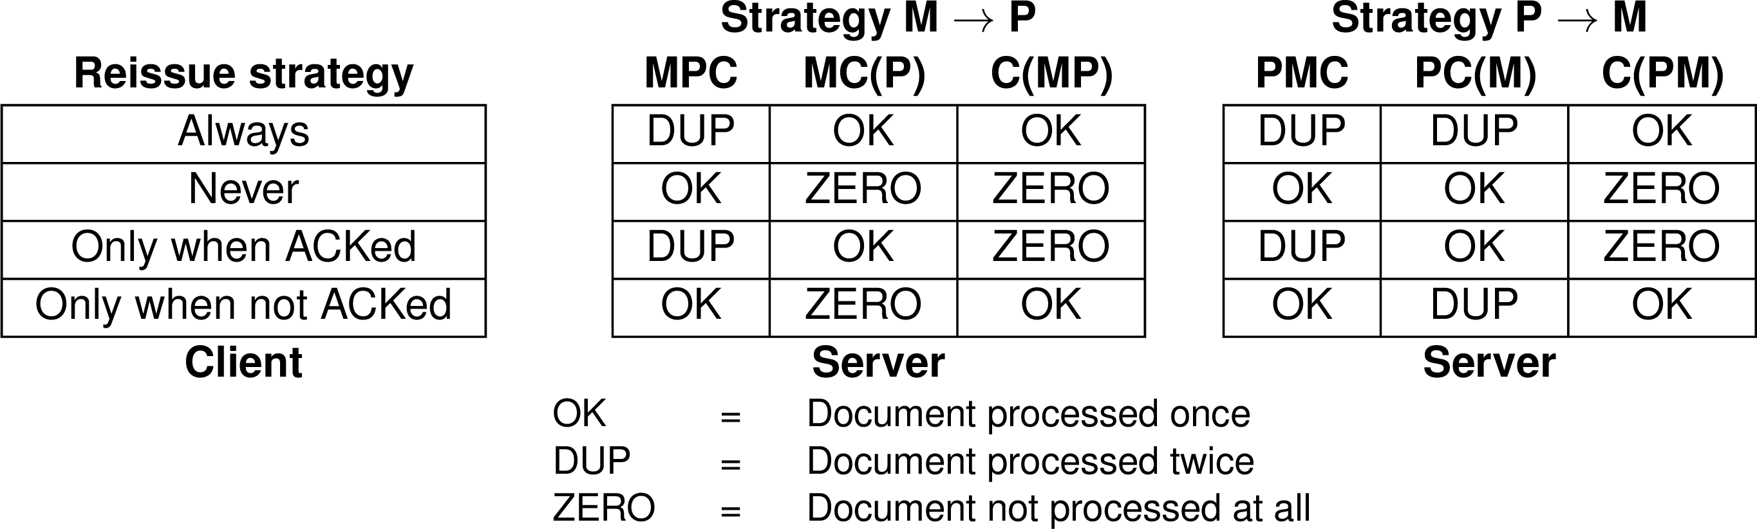
Fault tolerance
Reliable client-server communication
Why fully transparent server recovery is impossible
RPC semantics in the presence of failures

Slide 73
Reliable RPC: lost reply messages
Fault tolerance Reliable client-server communication
The real issue
What the client notices, is that it is not getting an answer. However, it cannot decide whether this is caused by a lost request, a crashed server, or a lost response.
Partial solution
Design the server such that its operations are idempotent: repeating the same operation is the same as carrying it out exactly once:
pure read operations
strict overwrite operations
Many operations are inherently nonidempotent, such as many banking transactions.
RPC semantics in the presence of failures
Notes:
If a user sends a money transfer request to a bank server and it executes the required RPC but crashes before sending confirmation message, now client assuming issue on other end, sends same request again, should same transaction be performed again? Solution: Use sequence numbers to entertain same request on once (idempotent)

Slide 74
Reliable RPC: client crash
Fault tolerance Reliable client-server communication
Problem
The server is doing work and holding resources for nothing (called doing an orphan computation).
Solution
Orphan is killed (or rolled back) by the client when it recovers
Client broadcasts new epoch number when recovering ⇒ server kills client’s orphans (reincarnation)
Kill the computation if owners are not located in a given epoch (gentle reincarnation)
Require computations to complete in a T time units. Old ones are simply removed.
RPC semantics in the presence of failures
Notes:
Client asked the server to return 2GB bytes of 10 files, and client crashed after sending the request, now on server side, all the files are locked (also shared one) and cannot be used by any other and leads towards orphaned computation leading towards wastage of resources. If orphaned is killed, all associated locks will be lost, if it has initiated some other process, it will be difficult to trace back.
Incarnation: Identity of a node that performed in a distributed system, crashed and came back again. [Version of a specific entity state]

Slide 75
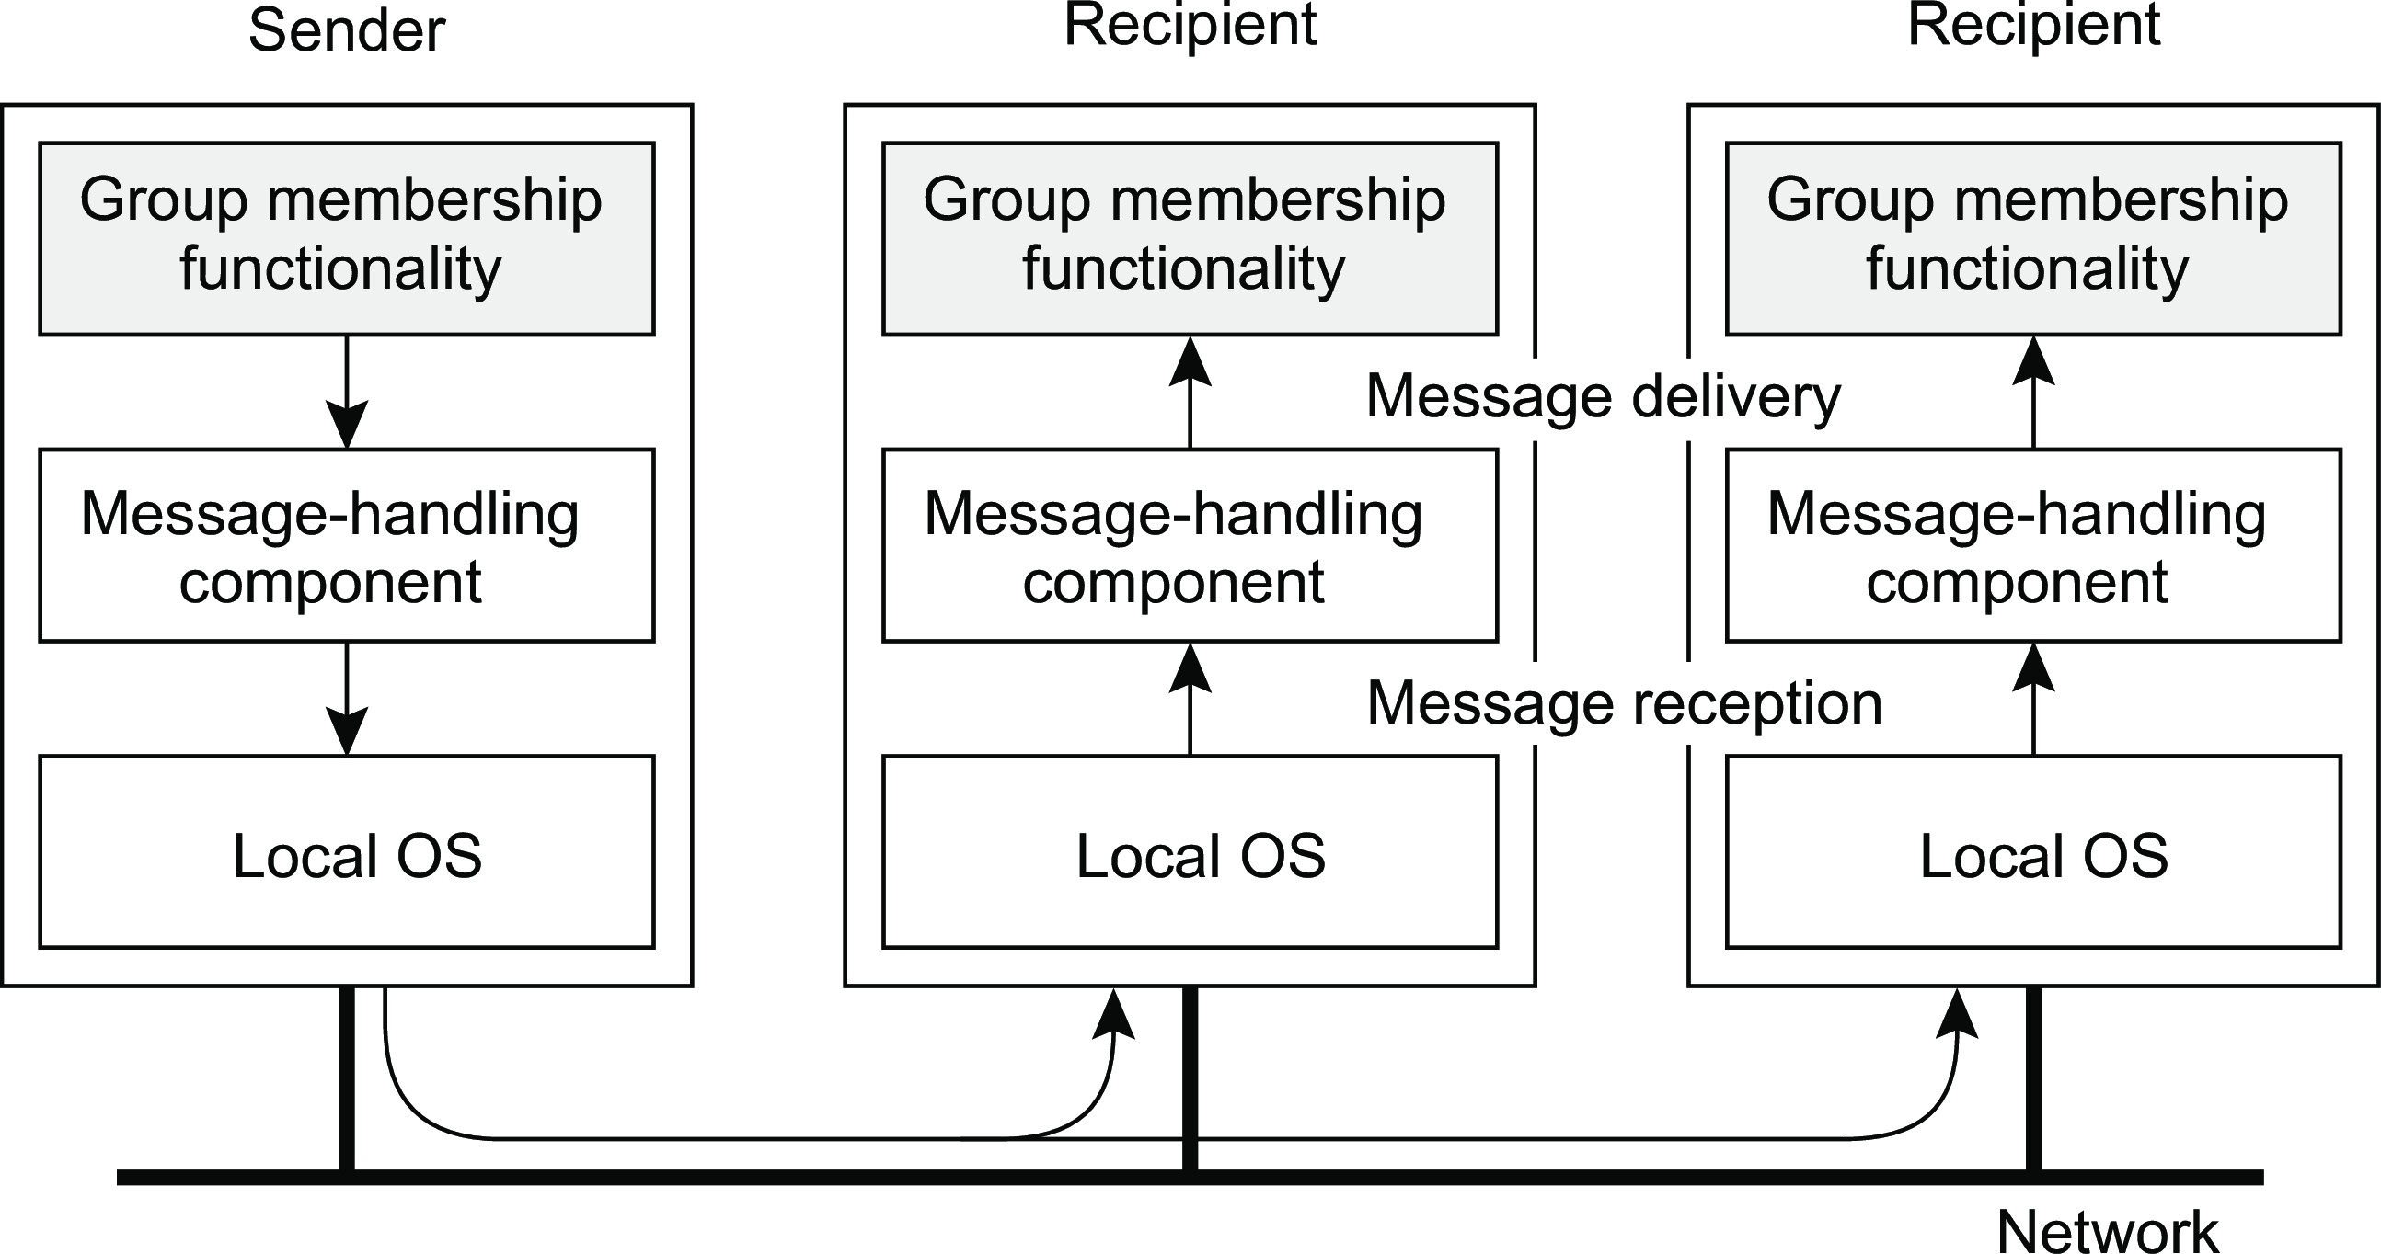
Simple reliable group communication
Fault tolerance Reliable group communication
Intuition
A message sent to a process group G should be delivered to each member of
G. Important: make distinction between receiving and delivering messages.
Introduction

Slide 76
Less simple reliable group communication
Fault tolerance Reliable group communication
Reliable communication in the presence of faulty processes
Group communication is reliable when it can be guaranteed that a message is received and subsequently delivered by all nonfaulty group members.
Tricky part
Agreement is needed on what the group actually looks like before a received message can be delivered.
Introduction

Slide 77
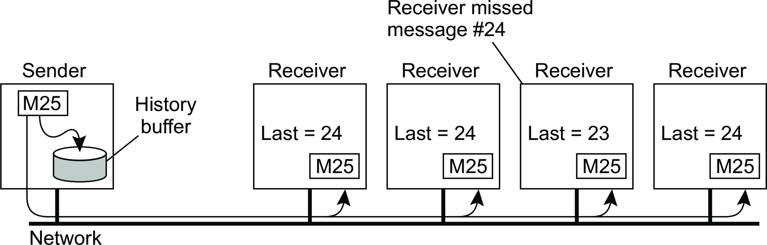
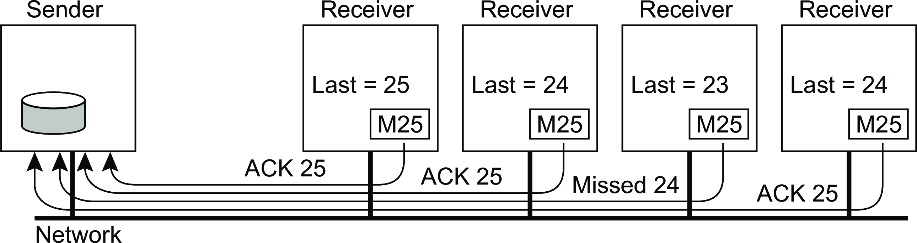
Simple reliable group communication
Fault tolerance Reliable group communication
Reliable communication, but assume nonfaulty processes
Reliable group communication now boils down to reliable multicasting: is a message received and delivered to each recipient, as intended by the sender.
Introduction

Slide 78
Simple reliable group communication
Fault tolerance Reliable group communication
Sender sent a message with sequence # 25 and stored in history buffer till all acknowledgements are received. Receiver will compare the sequence number with last message, packet sequence # and send a negative acknowledgement (NACK) for the missing one and sender will send it from history buffer.
Scalability of this solution is limited, and this approach is only applicable when group size is not very large. If there are N receivers of a message, then N acknowledgements will be received at sender side resulting in feedback implosion.
Introduction

Slide 79
Simple reliable group communication
Fault tolerance Reliable group communication
Sender sent a message with sequence # 25 and stored in history buffer till all acknowledgements are received. Receiver will compare the sequence number with last message, packet sequence # and send a negative acknowledgement (NACK) for the missing one and sender will send it from history buffer.
Scalability of this solution is limited, and this approach is only applicable when group size is not very large. If there are N receivers of a message, then N acknowledgements will be received at sender side resulting in feedback implosion.
Problem
How to reduce number of messages (ACKs) from receiver?
Introduction

Slide 80
Simple reliable group communication
Fault tolerance Reliable group communication
Sender sent a message with sequence # 25 and stored in history buffer till all acknowledgements are received. Receiver will compare the sequence number with last message, packet sequence # and send a negative acknowledgement (NACK) for the missing one and sender will send it from history buffer.
Scalability of this solution is limited, and this approach is only applicable when group size is not very large. If there are N receivers of a message, then N acknowledgements will be received at sender side resulting in feedback implosion.
Problem
How to reduce number of messages (ACKs) from receiver?
Solution
Only those receivers are allowed to respond who have not received the message (NACKs). Non-hierarchical feedback control or feedback suppression
Introduction

Slide 81
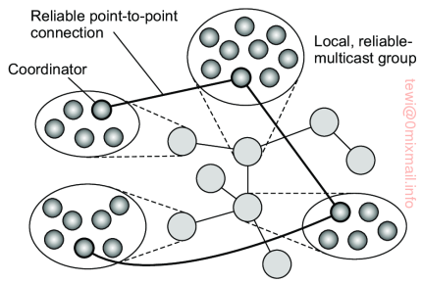
Simple reliable group communication
Fault tolerance Reliable group communication
Other Solutions
Hierarchical feedback
Organize group of processes to sub-groups and assign each group a unique coordinator
A link in the tree between two coordinators of respective subgroup corresponds to a reliable connection
When a process S in group G wants to send a message, it simply forwards the message to its coordinator which further sends message to its neighboring coordinator, each coordinator finally sends the message to their respective subgroup
Introduction

Slide 82
Simple reliable group communication
Fault tolerance Reliable group communication
Other Solutions
Hierarchical feedback
ACK-based scheme, if coordinator C of group G sends message to coordinator C’ of group G’, it will keep message in its history buffer at least until C’ has sent an acknowledgement
NACK-based scheme, only if G’ detects that it has missed the message, it will send NACK to C
Main problem lies in management of dynamic group creation, coordinator election, tree management
Gossip based scalable reliable multicasting
In this scheme, a node P picks another node Q at random and subsequently exchanges updates with Q. In other words, P pushes updates that Q has not seen before to Q, and pulls in any updates that Q has, but which were missed by P. After the exchange, both processes have the same data.
If communication between P and Q fails for some reason, P will simply pick some other node to exchange updates.
Introduction

Slide 83
Simple reliable group communication
Fault tolerance Reliable group communication
Atomic Multicast
A message is delivered to either all group members or to none at all.
In distributed transaction, a transaction should be performed to all replicas
A client contacts a replica P and request it to perform an update. The replica does so by multicasting the updates to the other group members. Unfortunately, before the multicast completes, P crashes, leaving the rest of the group in a difficult position: some group members will have received the update request; others will not.
Introduction

Slide 84
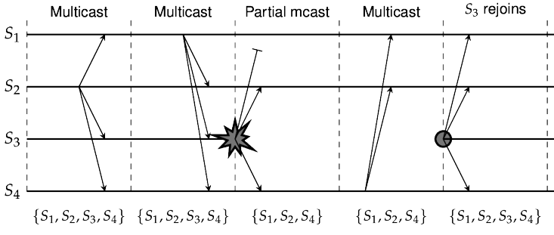
Simple reliable group communication
Fault tolerance Reliable group communication
Virtual Synchrony
A message is delivered by the process P keeping in view current group view
When a new process joins the group, it forwards view change request to other members
Introduction
Notes:
View change message will be sent by the process who wants to join or leave the group or about some other failed process which should be removed from current view.

Slide 85
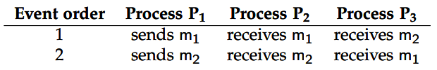
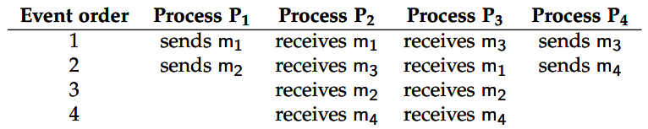
Simple reliable group communication
Fault tolerance Reliable group communication
Message Ordering
Unordered multicast provides no guarantees of in-order delivery of message
FIFO-ordered multicast provides guarantees of in-order delivery of message
Introduction

Slide 86
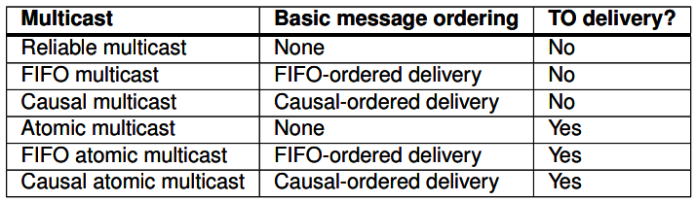
Simple reliable group communication
Fault tolerance Reliable group communication
Message Ordering
Casually-ordered multicast provides guarantees of in-order delivery of message which casually proceed after each other
Totally-ordered multicast provides guarantees of receiving message in same order at each receiver whether it is actually ordered or un-ordered.
Introduction

Slide 87
Distributed commit protocols
Fault tolerance Distributed commit
Problem
Have an operation being performed by each member of a process group, or none at all.
Reliable multicasting: a message is to be delivered to all recipients.
Distributed transaction: each local transaction must succeed.

Slide 88
Two-phase commit protocol (2PC)
Fault tolerance Distributed commit
Essence
The client who initiated the computation acts as coordinator; processes required to commit are the participants.
Phase 1a: Coordinator sends VOTE-REQUEST to participants (also called a pre-write)
Phase 1b: When participant receives VOTE-REQUEST it returns either VOTE-COMMIT or VOTE-ABORT to coordinator. If it sends VOTE-ABORT, it aborts its local computation
Phase 2a: Coordinator collects all votes; if all are VOTE-COMMIT, it sends
GLOBAL-COMMIT to all participants, otherwise it sends GLOBAL-ABORT
Phase 2b: Each participant waits for GLOBAL-COMMIT or GLOBAL-ABORT
and handles accordingly.

Slide 89
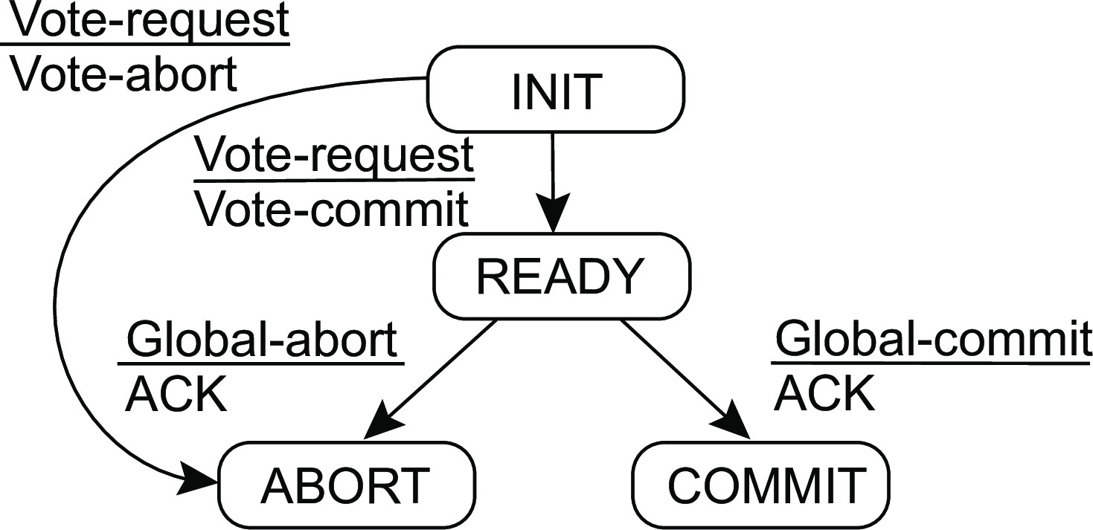
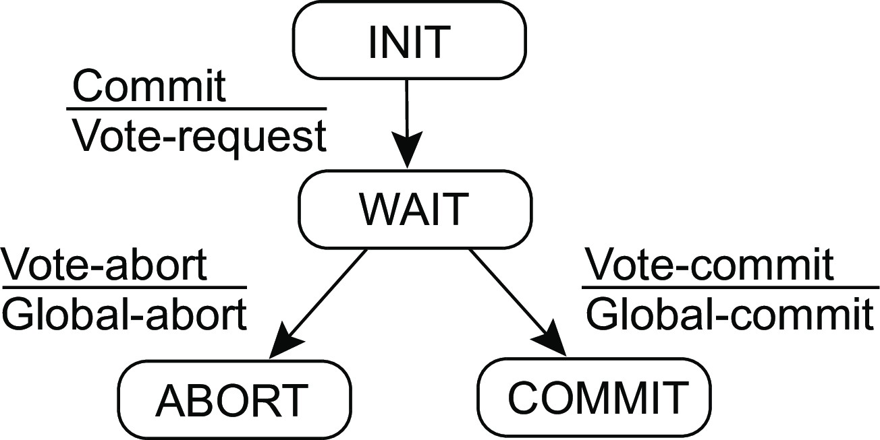
Fault tolerance
Distributed commit
2PC - Finite state machines
Coordinator
Participant

Slide 90
Fault tolerance
Distributed commit
2PC – Failing participant
Analysis: participant crashes in state S, and recovers to S
INIT : No problem: participant was unaware of protocol

Slide 91
Fault tolerance
Distributed commit
2PC – Failing participant
Analysis: participant crashes in state S, and recovers to S
READY : Participant is waiting to either commit or abort. After recovery, participant needs to know which state transition it should make ⇒ log the coordinator’s decision

Slide 92
Fault tolerance
Distributed commit
2PC – Failing participant
Analysis: participant crashes in state S, and recovers to S
ABORT : Merely make entry into abort state idempotent, e.g., removing the workspace of results

Slide 93
Fault tolerance
Distributed commit
2PC – Failing participant
Analysis: participant crashes in state S, and recovers to S
COMMIT : Also make entry into commit state idempotent, e.g., copying workspace to storage.

Slide 94
2PC – Failing participant
Fault tolerance Distributed commit
Analysis: participant crashes in state S, and recovers to S
INIT : No problem: participant was unaware of protocol
READY : Participant is waiting to either commit or abort. After recovery, participant needs to know which state transition it should make ⇒ log the coordinator’s decision
ABORT : Merely make entry into abort state idempotent, e.g., removing the workspace of results
COMMIT : Also make entry into commit state idempotent, e.g., copying workspace to storage.
Observation
When distributed commit is required, having participants use temporary workspaces to keep their results allows for simple recovery in the presence of failures.

Slide 95
2PC – Failing participant
Fault tolerance Distributed commit
Alternative
When a recovery is needed to READY state, check state of other participants
⇒ no need to log coordinator’s decision.
Recovering participant P contacts another participant Q
State of Q | Action by P
COMMIT | Make transition to COMMIT
ABORT | Make transition to ABORT
INIT | Make transition to ABORT
READY | Contact another participant
Result
If all participants are in the READY state, the protocol blocks. Apparently, the coordinator is failing. Note: The protocol prescribes that we need the decision from the coordinator.

Slide 96
2PC – Failing coordinator
Fault tolerance Distributed commit
Observation
The real problem lies in the fact that the coordinator’s final decision may not be available for some time (or actually lost).
Alternative
Let a participant P in the READY state timeout when it hasn’t received the coordinator’s decision; P tries to find out what other participants know (as discussed).
Observation
Essence of the problem is that a recovering participant cannot make a local decision: it is dependent on other (possibly failed) processes

Slide 97
Fault tolerance
Distributed commit
Coordinator in Python
1 class Coordinator:
2
3
4
5
6
7
8
9
10
11
12
13
14
15
def run(self):
yetToReceive = list(self.participants) self.log.info(’WAIT’) self.chan.sendTo(self.participants, VOTE_REQUEST) while len(yetToReceive) > 0:
msg = self.chan.recvFrom(self.participants, BLOCK, TIMEOUT)
if msg == -1 or (msg[1] == VOTE_ABORT): self.log.info(’ABORT’) self.chan.sendTo(self.participants, GLOBAL_ABORT) return
else: # msg[1] == VOTE_COMMIT
yetToReceive.remove(msg[0]) self.log.info(’COMMIT’) self.chan.sendTo(self.participants, GLOBAL_COMMIT)

Slide 98
Fault tolerance
Distributed commit
Participant in Python
1 class Participant:
2
3
4
5
6
7
8
9
10
11
12
13
14
15
16
17
18
19
20
21
22
23
24
25
26
27
28
29
30
31
32
33
def run(self):
self.log.info(’INIT’)
msg = self.chan.recvFrom(self.coordinator, BLOCK, TIMEOUT)
if msg == -1: # Crashed coordinator - give up entirely
decision = LOCAL_ABORT
else: # Coordinator will have sent VOTE_REQUEST
decision = self.do_work()
if decision == LOCAL_ABORT: self.chan.sendTo(self.coordinator, VOTE_ABORT) self.log.info(’LOCAL_ABORT’)
else: # Ready to commit, enter READY state self.log.info(’READY’) self.chan.sendTo(self.coordinator, VOTE_COMMIT)
msg = self.chan.recvFrom(self.coordinator, BLOCK, TIMEOUT)
if msg == -1: # Crashed coordinator - check the others self.log.info(’NEED_DECISION’) self.chan.sendTo(self.participants, NEED_DECISION) while True:
msg = self.chan.recvFromAny()
if msg[1] in [GLOBAL_COMMIT, GLOBAL_ABORT, LOCAL_ABORT]:
decision = msg[1]
break
else: # Coordinator came to a decision
decision = msg[1]
if decision == GLOBAL_COMMIT: self.log.info(’COMMIT’)
else: # decision in [GLOBAL_ABORT, LOCAL_ABORT]:
self.log.info(’ABORT’)
while True: # Help any other participant when coordinator crashed
msg = self.chan.recvFrom(self.participants)
if msg[1] == NEED_DECISION:
self.chan.sendTo([msg[0]], decision)

Slide 99
Fault tolerance
Recovery
Recovery: Background
Essence
When a failure occurs, we need to bring the system into an error-free state:
Forward error recovery: Find a new state from which the system can continue operation
Backward error recovery: Bring the system back into a previous error-free state
Practice
Use backward error recovery, requiring that we establish recovery points
Observation
Recovery in distributed systems is complicated by the fact that processes need to cooperate in identifying a consistent state from where to recover
Introduction
Notes:
Packet retransmission in reliable communication is an example of backward error recovery.

Slide 100
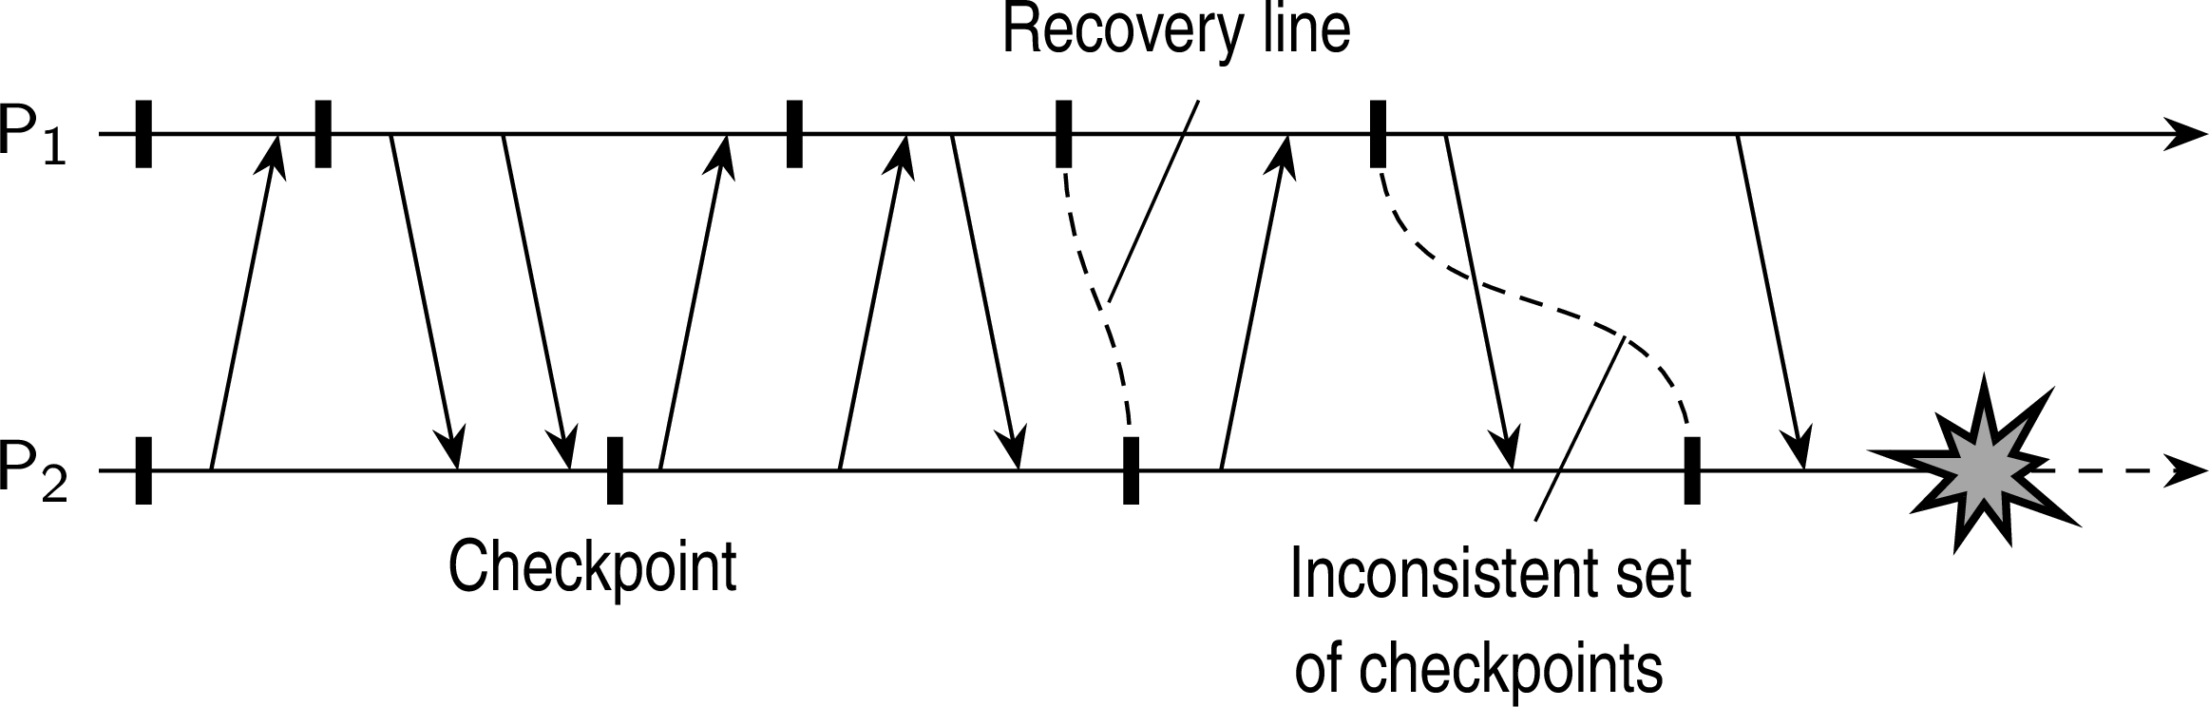
Fault tolerance
Recovery
Consistent recovery state
Requirement
Every message that has been received is also shown to have been sent in the state of the sender.
Recovery line
Assuming processes regularly checkpoint their state, the most recent consistent global checkpoint.
Checkpointing

Slide 101
Fault tolerance
Recovery
Coordinated checkpointing
Essence
Each process takes a checkpoint after a globally coordinated action.
Simple solution
Use a two-phase blocking protocol:
Checkpointing

Slide 102
Fault tolerance
Recovery
Coordinated checkpointing
Essence
Each process takes a checkpoint after a globally coordinated action.
Simple solution
Use a two-phase blocking protocol:
A coordinator multicasts a checkpoint request message
Checkpointing

Slide 103
Fault tolerance
Recovery
Coordinated checkpointing
Essence
Each process takes a checkpoint after a globally coordinated action.
Simple solution
Use a two-phase blocking protocol:
A coordinator multicasts a checkpoint request message
When a participant receives such a message, it takes a checkpoint, stops sending (application) messages, and reports back that it has taken a checkpoint
Checkpointing

Slide 104
Fault tolerance
Recovery
Coordinated checkpointing
Essence
Each process takes a checkpoint after a globally coordinated action.
Simple solution
Use a two-phase blocking protocol:
A coordinator multicasts a checkpoint request message
When a participant receives such a message, it takes a checkpoint, stops sending (application) messages, and reports back that it has taken a checkpoint
When all checkpoints have been confirmed at the coordinator, the latter broadcasts a checkpoint done message to allow all processes to continue
Checkpointing

Slide 105
Fault tolerance
Recovery
Coordinated checkpointing
Essence
Each process takes a checkpoint after a globally coordinated action.
Simple solution
Use a two-phase blocking protocol:
A coordinator multicasts a checkpoint request message
When a participant receives such a message, it takes a checkpoint, stops sending (application) messages, and reports back that it has taken a checkpoint
When all checkpoints have been confirmed at the coordinator, the latter broadcasts a checkpoint done message to allow all processes to continue
Observation
It is possible to consider only those processes that depend on the recovery of the coordinator, and ignore the rest
Checkpointing

Slide 106
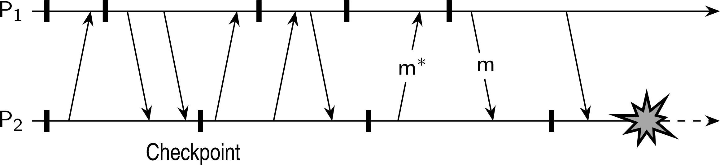
Fault tolerance
Recovery
Cascaded rollback
Observation
If checkpointing is done at the “wrong” instants, the recovery line may lie at system startup time. We have a so-called cascaded rollback.
Checkpointing

Slide 107
Fault tolerance
Recovery
Independent checkpointing
Essence
Each process independently takes checkpoints, with the risk of a cascaded rollback to system startup.
Checkpointing

Slide 108
Fault tolerance
Recovery
Independent checkpointing
Essence
Each process independently takes checkpoints, with the risk of a cascaded rollback to system startup.
Let CP_{i} (m) denote m^{th} checkpoint of process P_{i} and INT_{i} (m) the interval between CP_{i} (m − 1) and CP_{i} (m).
Checkpointing

Slide 109
Fault tolerance
Recovery
Independent checkpointing
Essence
Each process independently takes checkpoints, with the risk of a cascaded rollback to system startup.
Let CP_{i} (m) denote m^{th} checkpoint of process P_{i} and INT_{i} (m) the interval between CP_{i} (m − 1) and CP_{i} (m).
When process P_{i} sends a message in interval INT_{i} (m), it piggybacks
(i, m)
Checkpointing

Slide 110
Fault tolerance
Recovery
Independent checkpointing
Essence
Each process independently takes checkpoints, with the risk of a cascaded rollback to system startup.
Let CP_{i} (m) denote m^{th} checkpoint of process P_{i} and INT_{i} (m) the interval between CP_{i} (m − 1) and CP_{i} (m).
When process P_{i} sends a message in interval INT_{i} (m), it piggybacks
(i, m)
When process P_{j} receives a message in interval INT_{j} (n), it records the dependency INT_{i} (m) → INT_{j} (n).
Checkpointing

Slide 111
Fault tolerance
Recovery
Independent checkpointing
Essence
Each process independently takes checkpoints, with the risk of a cascaded rollback to system startup.
Let CP_{i} (m) denote m^{th} checkpoint of process P_{i} and INT_{i} (m) the interval between CP_{i} (m − 1) and CP_{i} (m).
When process P_{i} sends a message in interval INT_{i} (m), it piggybacks
(i, m)
When process P_{j} receives a message in interval INT_{j} (n), it records the dependency INT_{i} (m) → INT_{j} (n).
The dependency INT_{i} (m) → INT_{j} (n) is saved to storage when taking checkpoint CP_{j} (n).
Checkpointing

Slide 112
Fault tolerance
Recovery
Independent checkpointing
Essence
Each process independently takes checkpoints, with the risk of a cascaded rollback to system startup.
Let CP_{i} (m) denote m^{th} checkpoint of process P_{i} and INT_{i} (m) the interval between CP_{i} (m − 1) and CP_{i} (m).
When process P_{i} sends a message in interval INT_{i} (m), it piggybacks
(i, m)
When process P_{j} receives a message in interval INT_{j} (n), it records the dependency INT_{i} (m) → INT_{j} (n).
The dependency INT_{i} (m) → INT_{j} (n) is saved to storage when taking checkpoint CP_{j} (n).
Observation
If process P_{i} rolls back to CP_{i} (m − 1), P_{j} must roll back to CP_{j} (n − 1).
Checkpointing

Slide 113
Fault tolerance
Recovery
Message logging
Alternative
Instead of taking an (expensive) checkpoint, try to replay your (communication) behavior from the most recent checkpoint ⇒ store messages in a log.
Assumption
We assume a piecewise deterministic execution model:
The execution of each process can be considered as a sequence of state intervals
Each state interval starts with a nondeterministic event (e.g., message receipt)
Execution in a state interval is deterministic
Conclusion
If we record nondeterministic events (to replay them later), we obtain a deterministic execution model that will allow us to do a complete replay.
Message logging

Slide 114
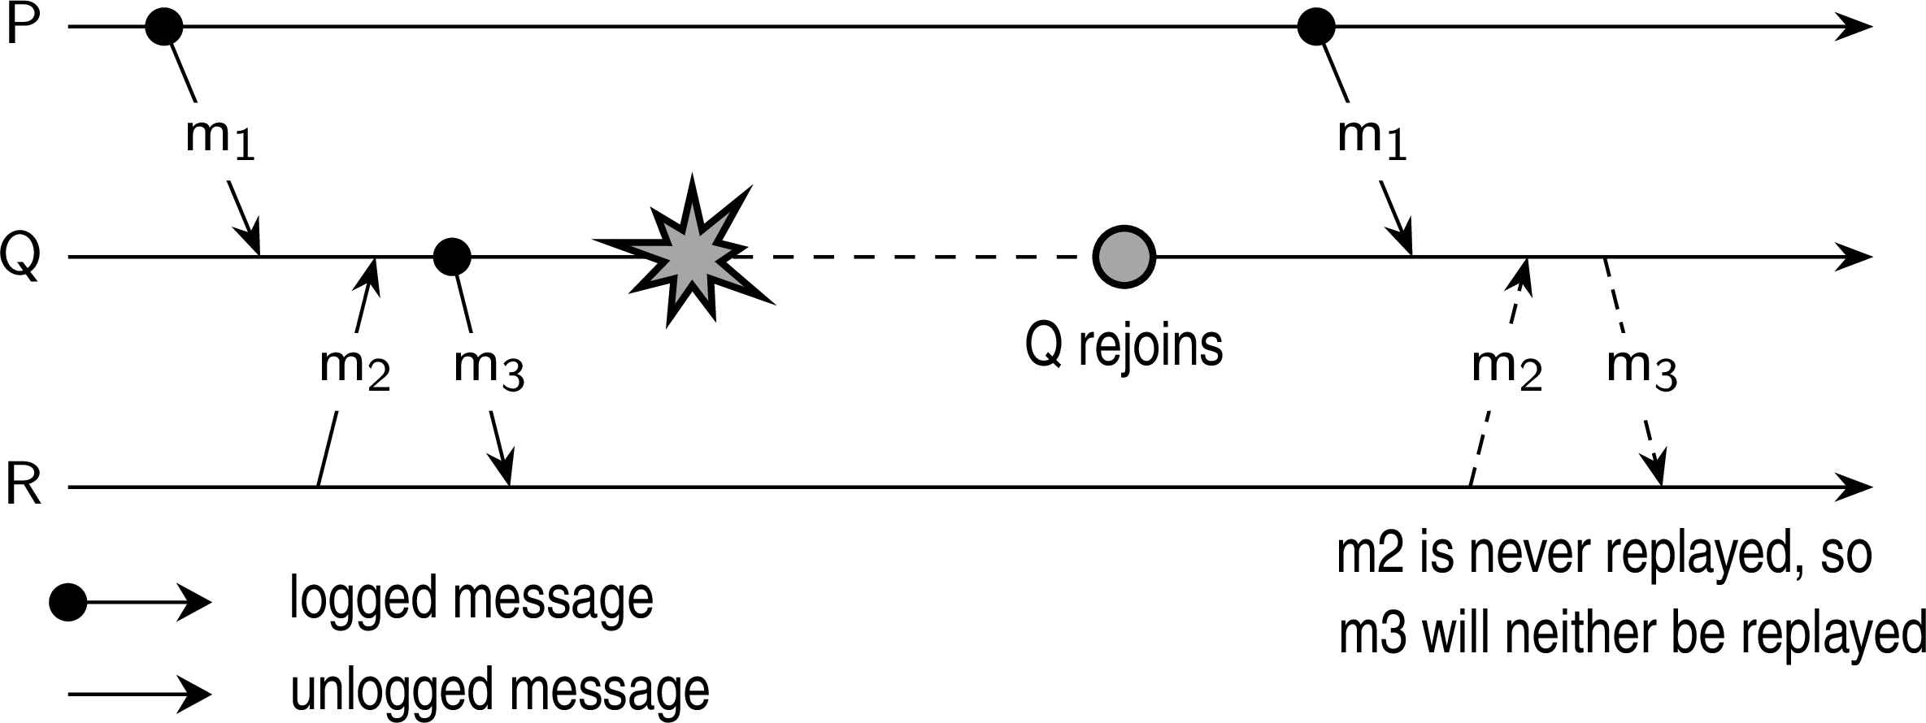
Fault tolerance
Recovery
Message logging and consistency
When should we actually log messages?
Avoid orphan processes:
Process Q has just received and delivered messages m₁ and m₂
Assume that m₂ is never logged.
After delivering m₁ and m₂ , Q sends message m₃ to process R
Process R receives and subsequently delivers m₃ : it is an orphan.
Message logging

Slide 115
Fault tolerance
Recovery
Message-logging schemes
Notations
DEP(m): processes to which m has been delivered. If message m∗ is causally dependent on the delivery of m, and m∗ has been delivered to Q, then Q ∈ DEP(m).
COPY(m): processes that have a copy of m, but have not (yet) reliably stored it.
FAIL: the collection of crashed processes.
Characterization
Q is orphaned ⇔ ∃m : Q ∈ DEP(m) and COPY(m) ⊆ FAIL
Message logging

Slide 116
Fault tolerance
Recovery
Message-logging schemes
Pessimistic protocol
For each nonstable message m, there is at most one process dependent on m, that is |DEP(m)| ≤ 1.
Consequence
An unstable message in a pessimistic protocol must be made stable before sending a next message.
Message logging
Notes:
Do the work before crash

Slide 117
Fault tolerance
Recovery
Message-logging schemes
Optimistic protocol
For each unstable message m, we ensure that if COPY(m) ⊆ FAIL, then eventually also DEP(m) ⊆ FAIL.
Consequence
To guarantee that DEP(m) ⊆ FAIL, we generally roll back each orphan process
Q until Q ̸∈ DEP(m).
Message logging

